Slide 1
Distribution of drug sensitivities
growth
IC₅₀
[Drug]

Slide 2
Distribution of drug sensitivities
growth
[Drug]

Slide 3
Distribution of drug sensitivities
growth
freq
1/3
1/3
1/3
[Drug]
Resistant
Intermediate
Sensitive
ActArea

Slide 4
Distribution of drug sensitivities
IC₅₀
ActArea
Resistant
Intermediate
Sensitive

Slide 5
Distribution of drug sensitivities
IC₅₀
Too high IC50 -> removed
Drug-specific threshold
Sources for threshold:
literature?
GDSC?
(exact same cell line, drugs, media, measurement etc.?)
Too low IC50 -> removed
ActArea
Other ideas: - minimum absolute ActArea?
- query individual dose-response curves (need to import and format more data)

Slide 6
Story for paper:
Advantage of stacking versus training one algo on entire data
Best predictivity for each algo / dataset / drug
Retrieval best features for each dataset (each algo in best stack) for each drug
(focus on a few drugs)
Demonstrate drug dependence for each feature (pdp plots, regressions)
Combine essential features into simple predictors (trees or logical)
Biological interpretation for most important features
Bonus points: link most predictive features to coherent mechanisms (prot + RNA + pathways…)
Issues remaining:
Retrieval of features (not working yet)
Import of genomic data
(import of CNV, histones, etc.)
Title? Model stacking as a tool to form interpretable multi-omic predictors of cancer pharmacosensitivity

Slide 7
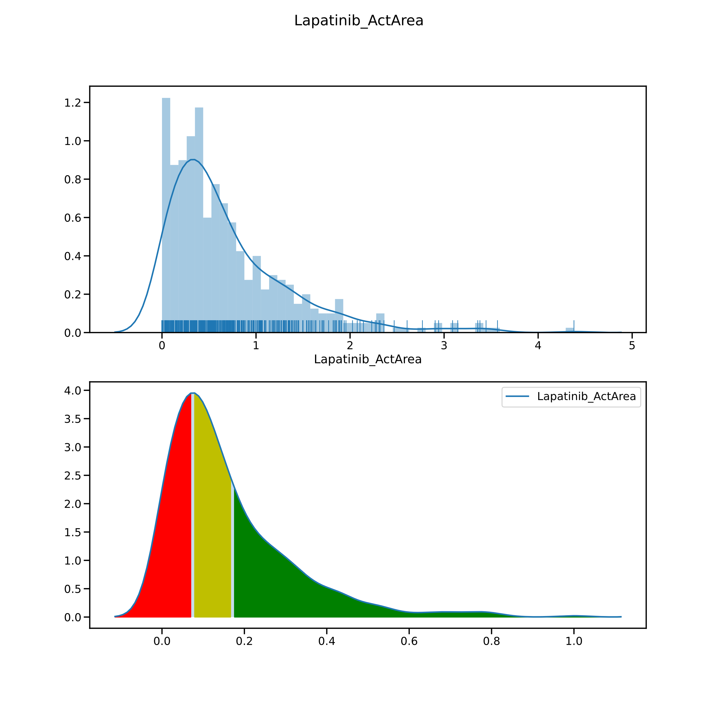
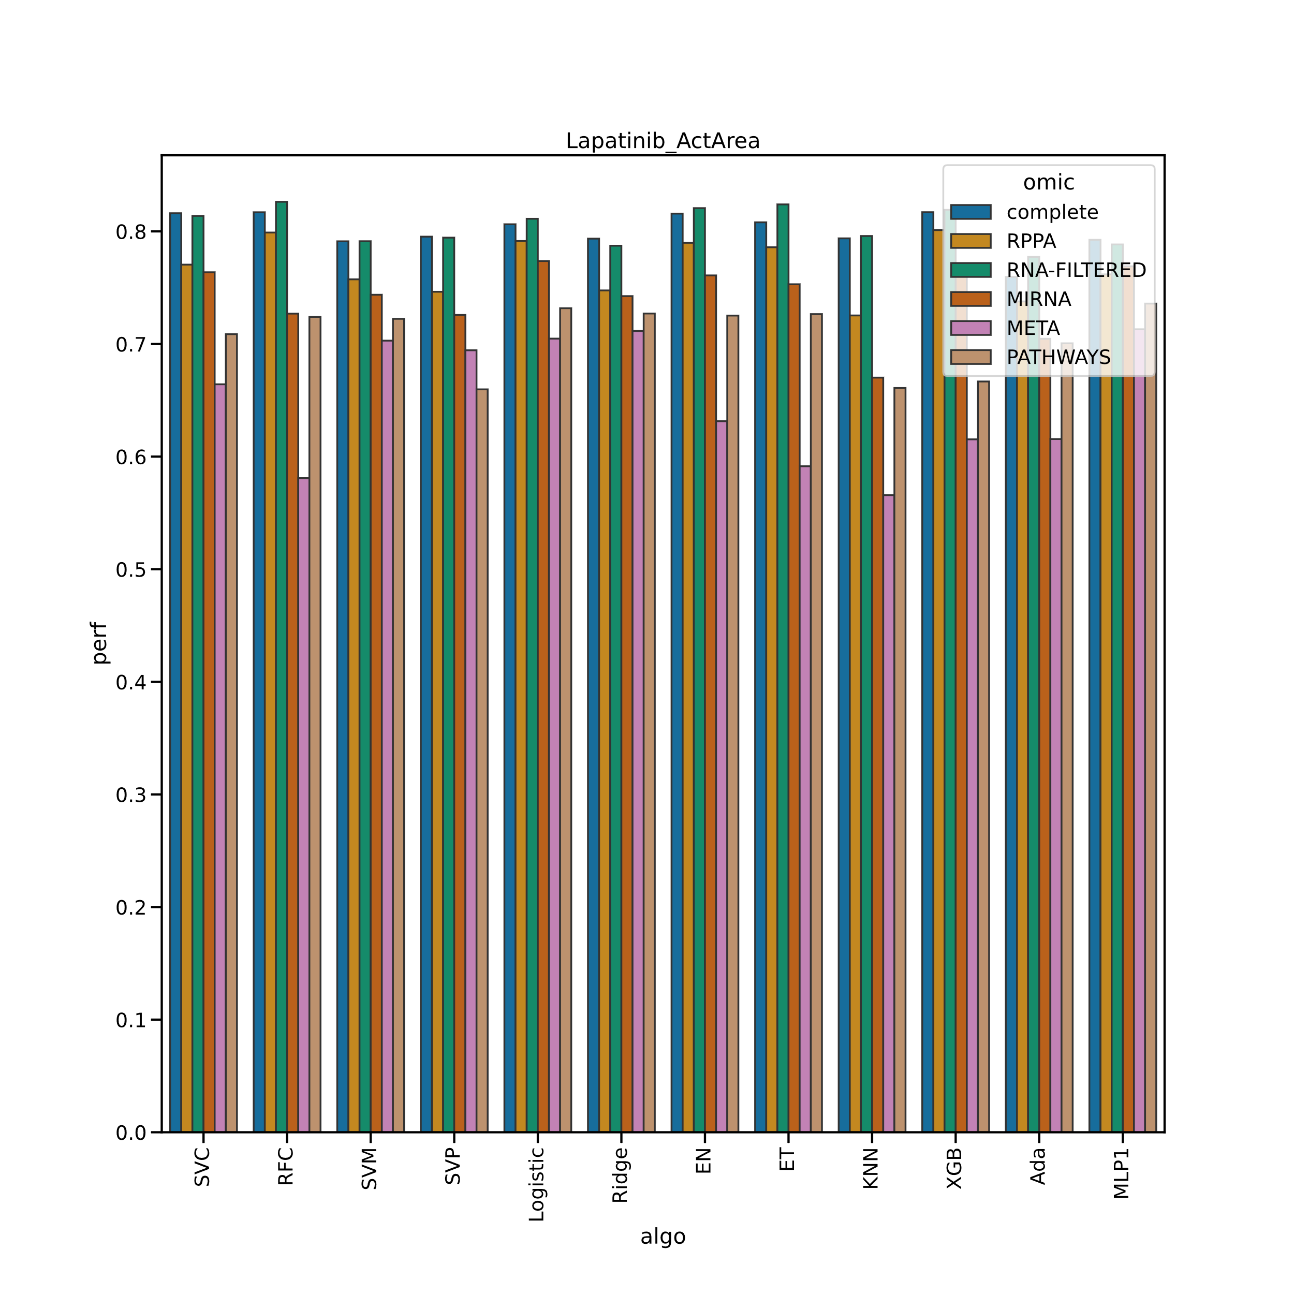

Slide 8
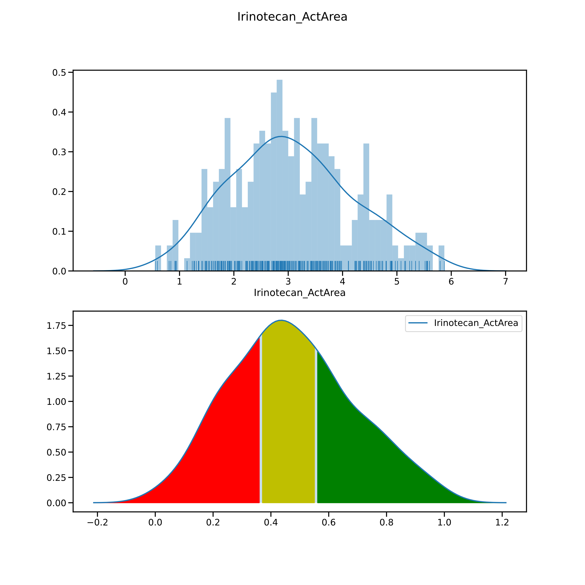
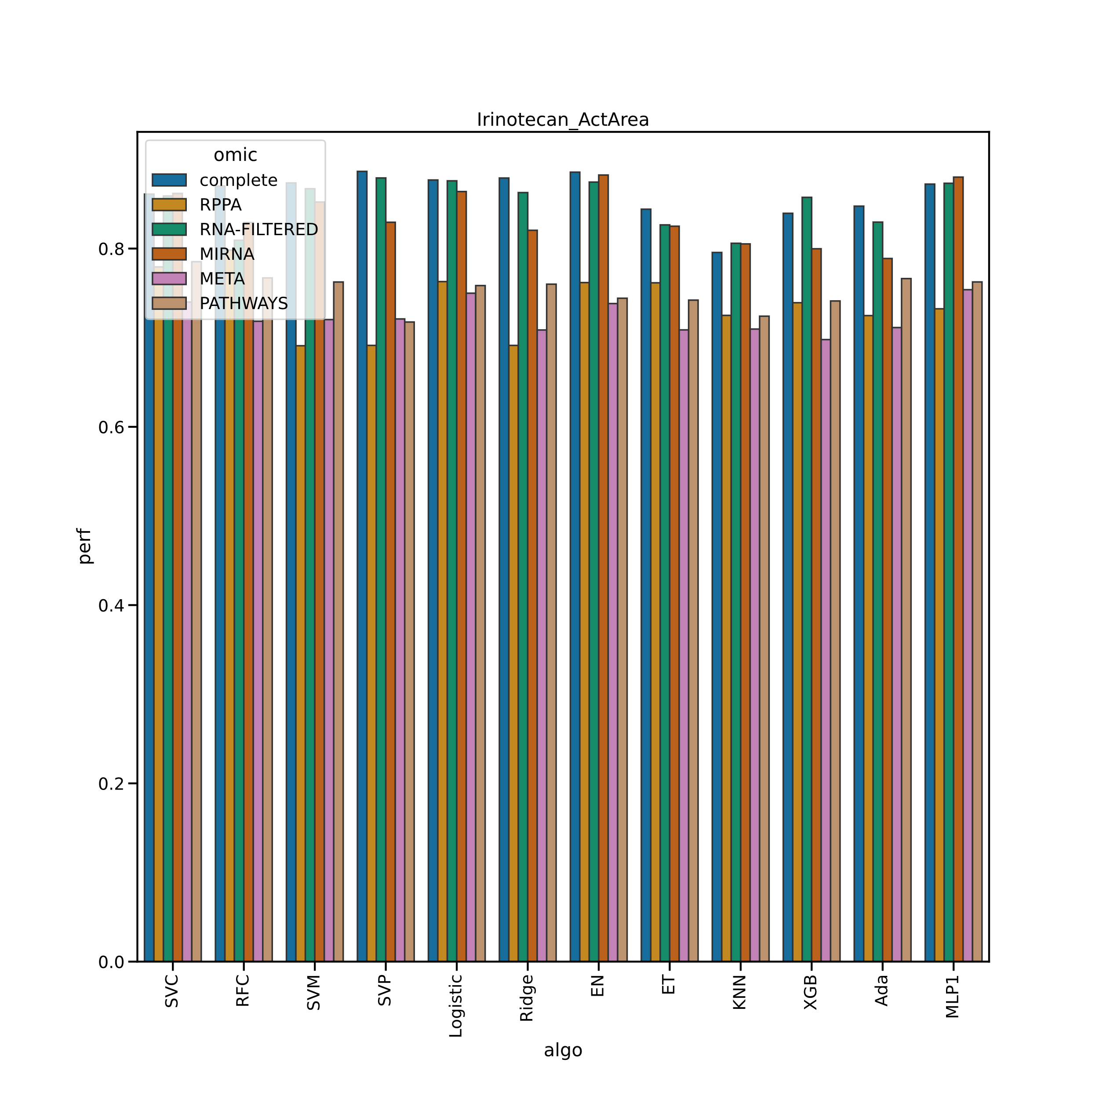

Slide 9
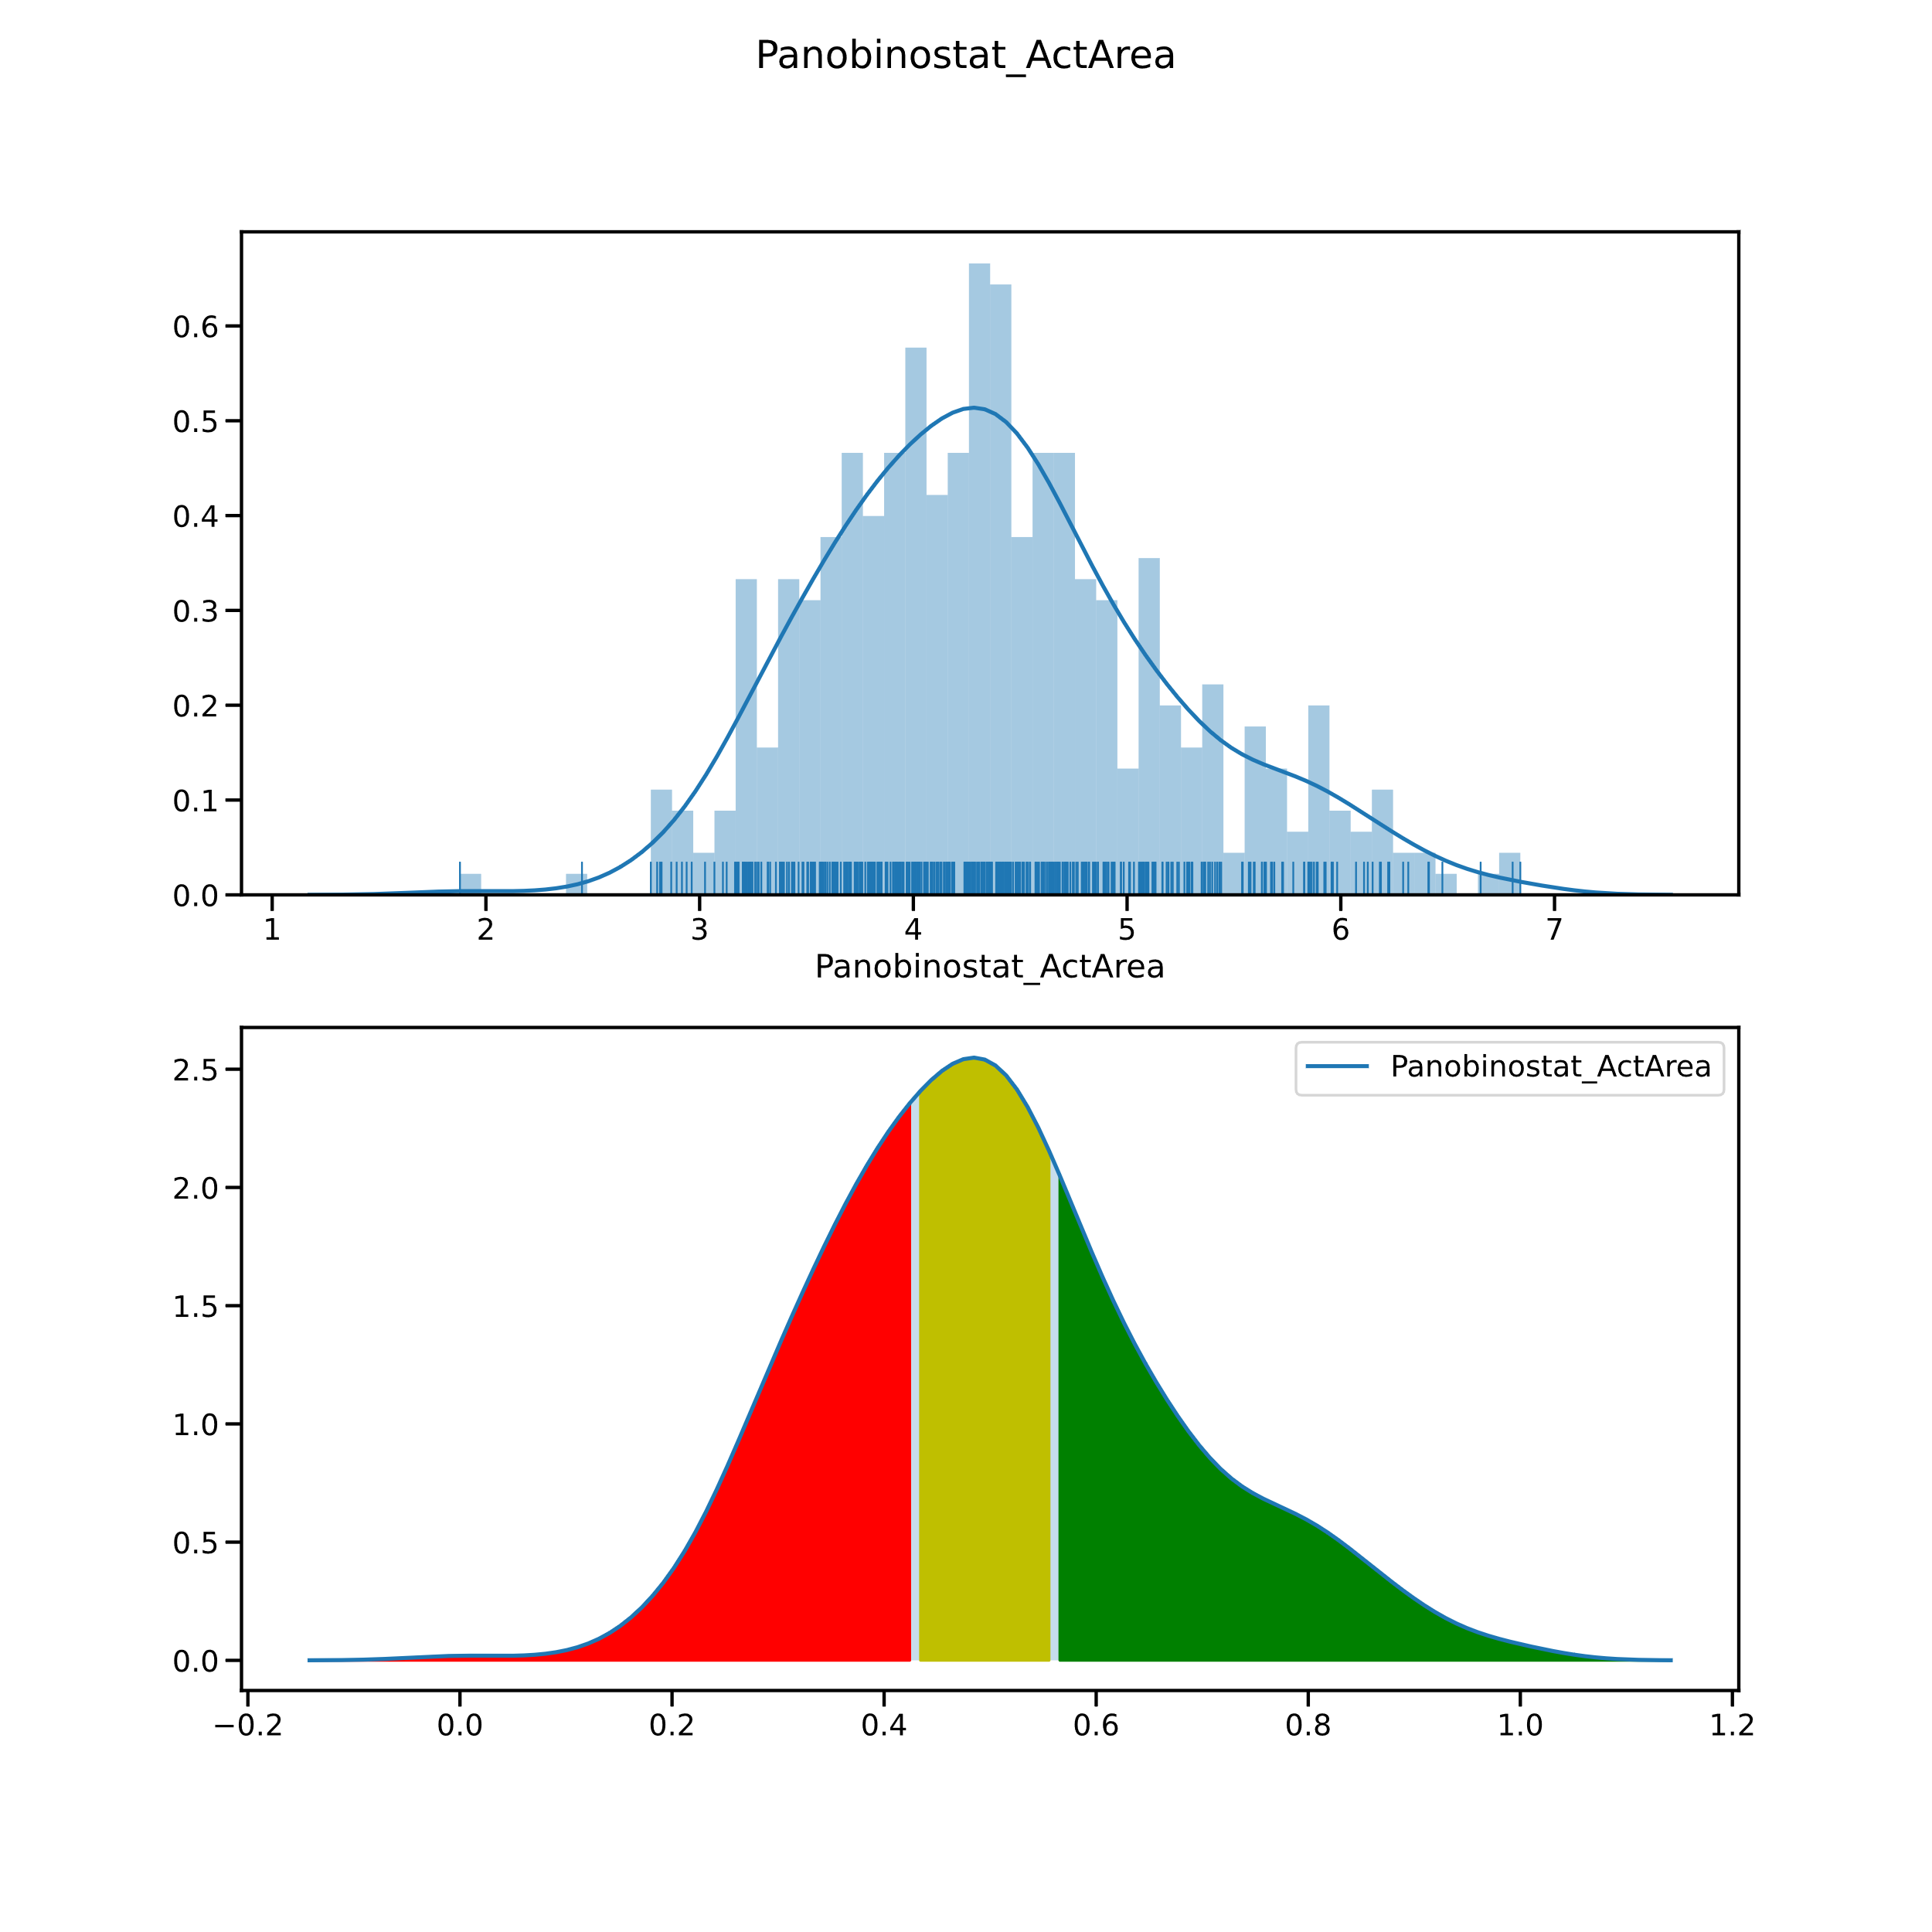
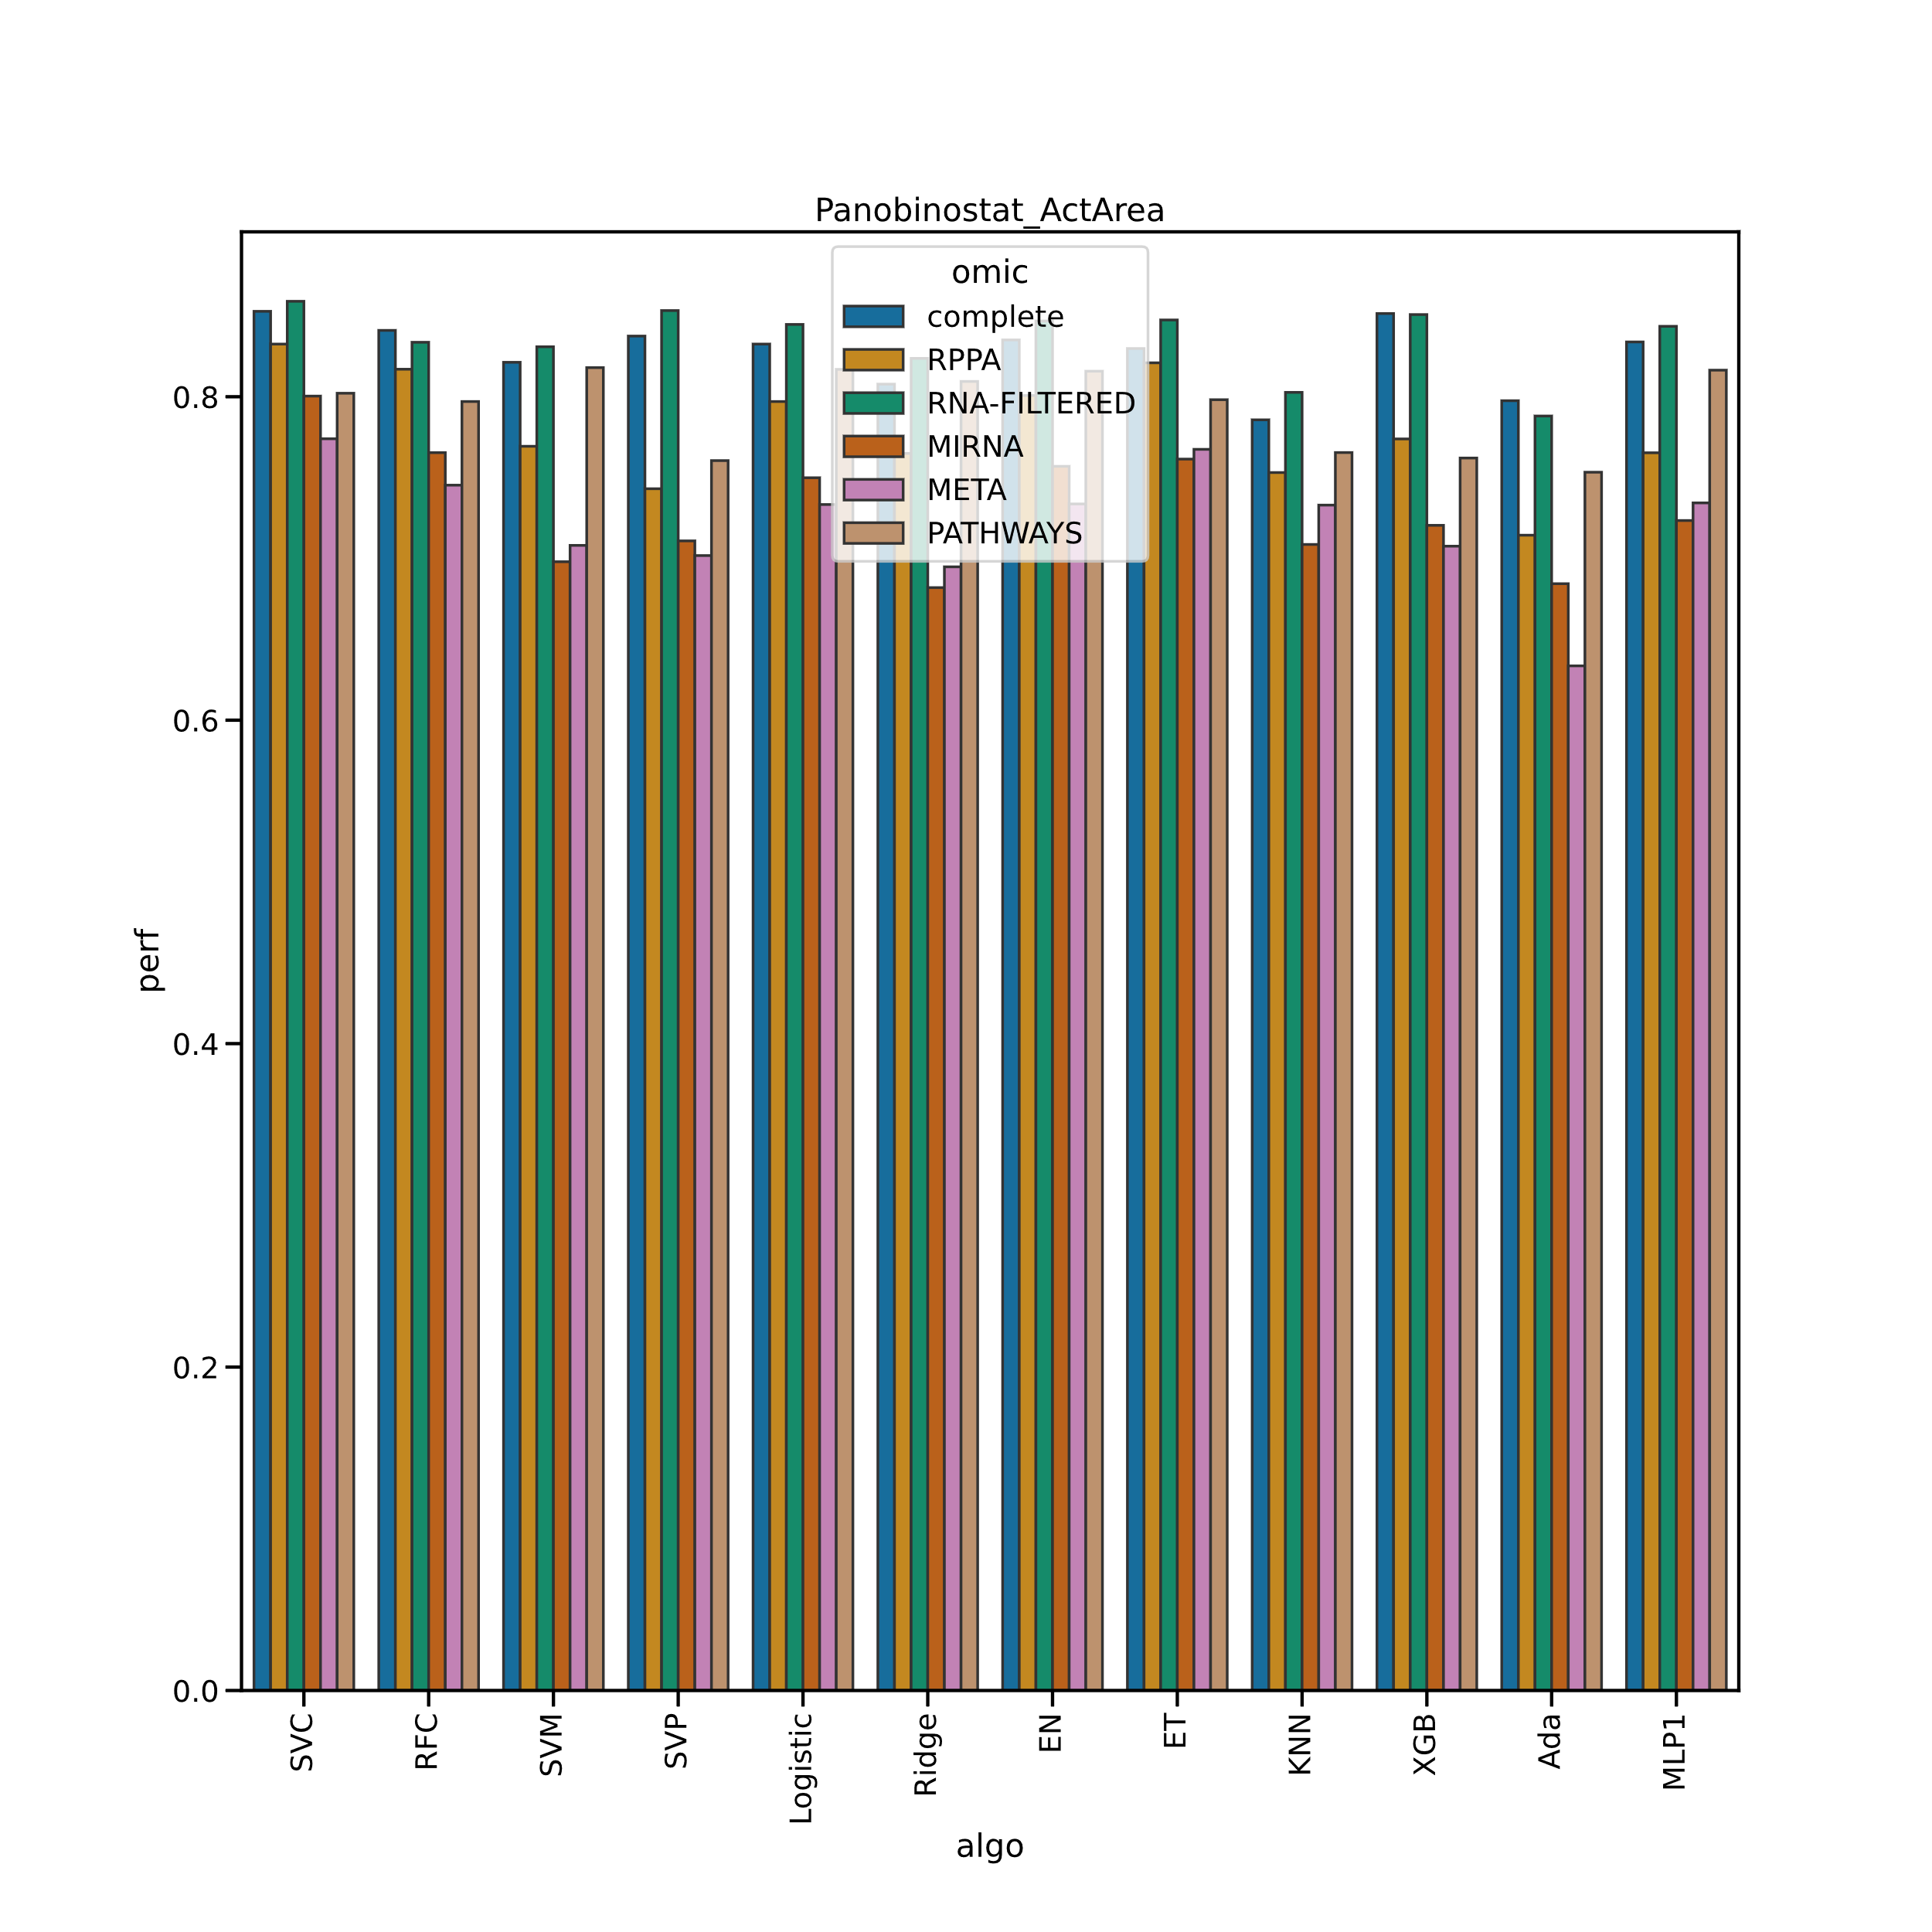

Slide 10
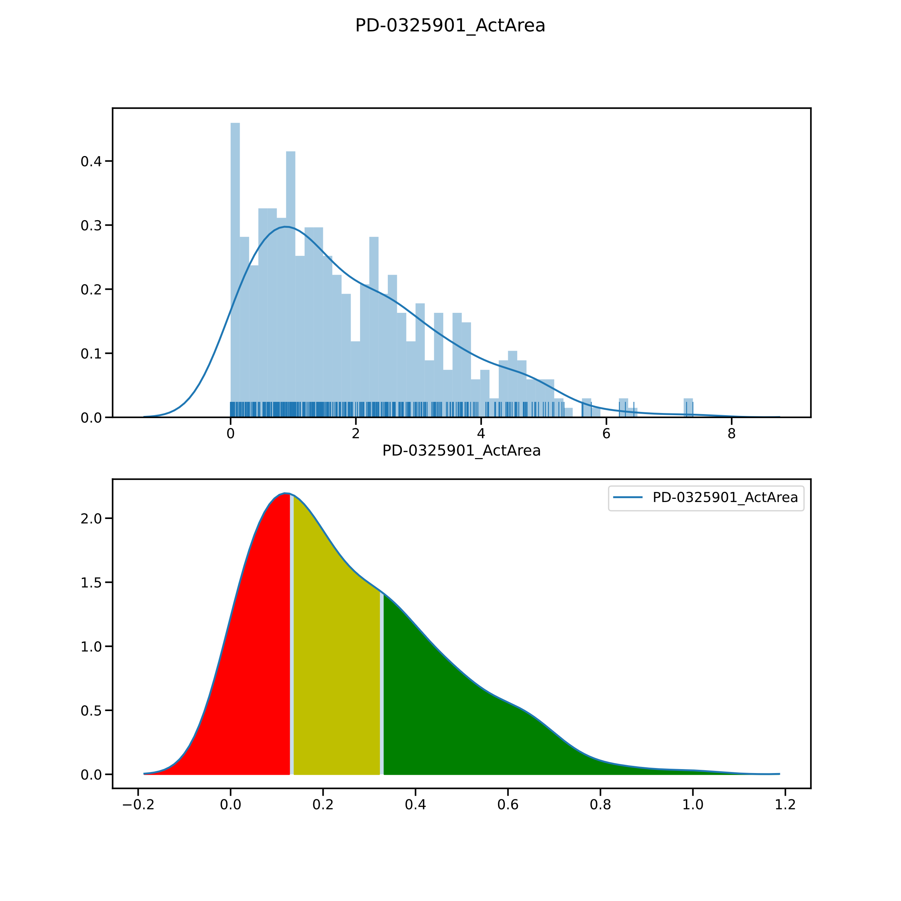
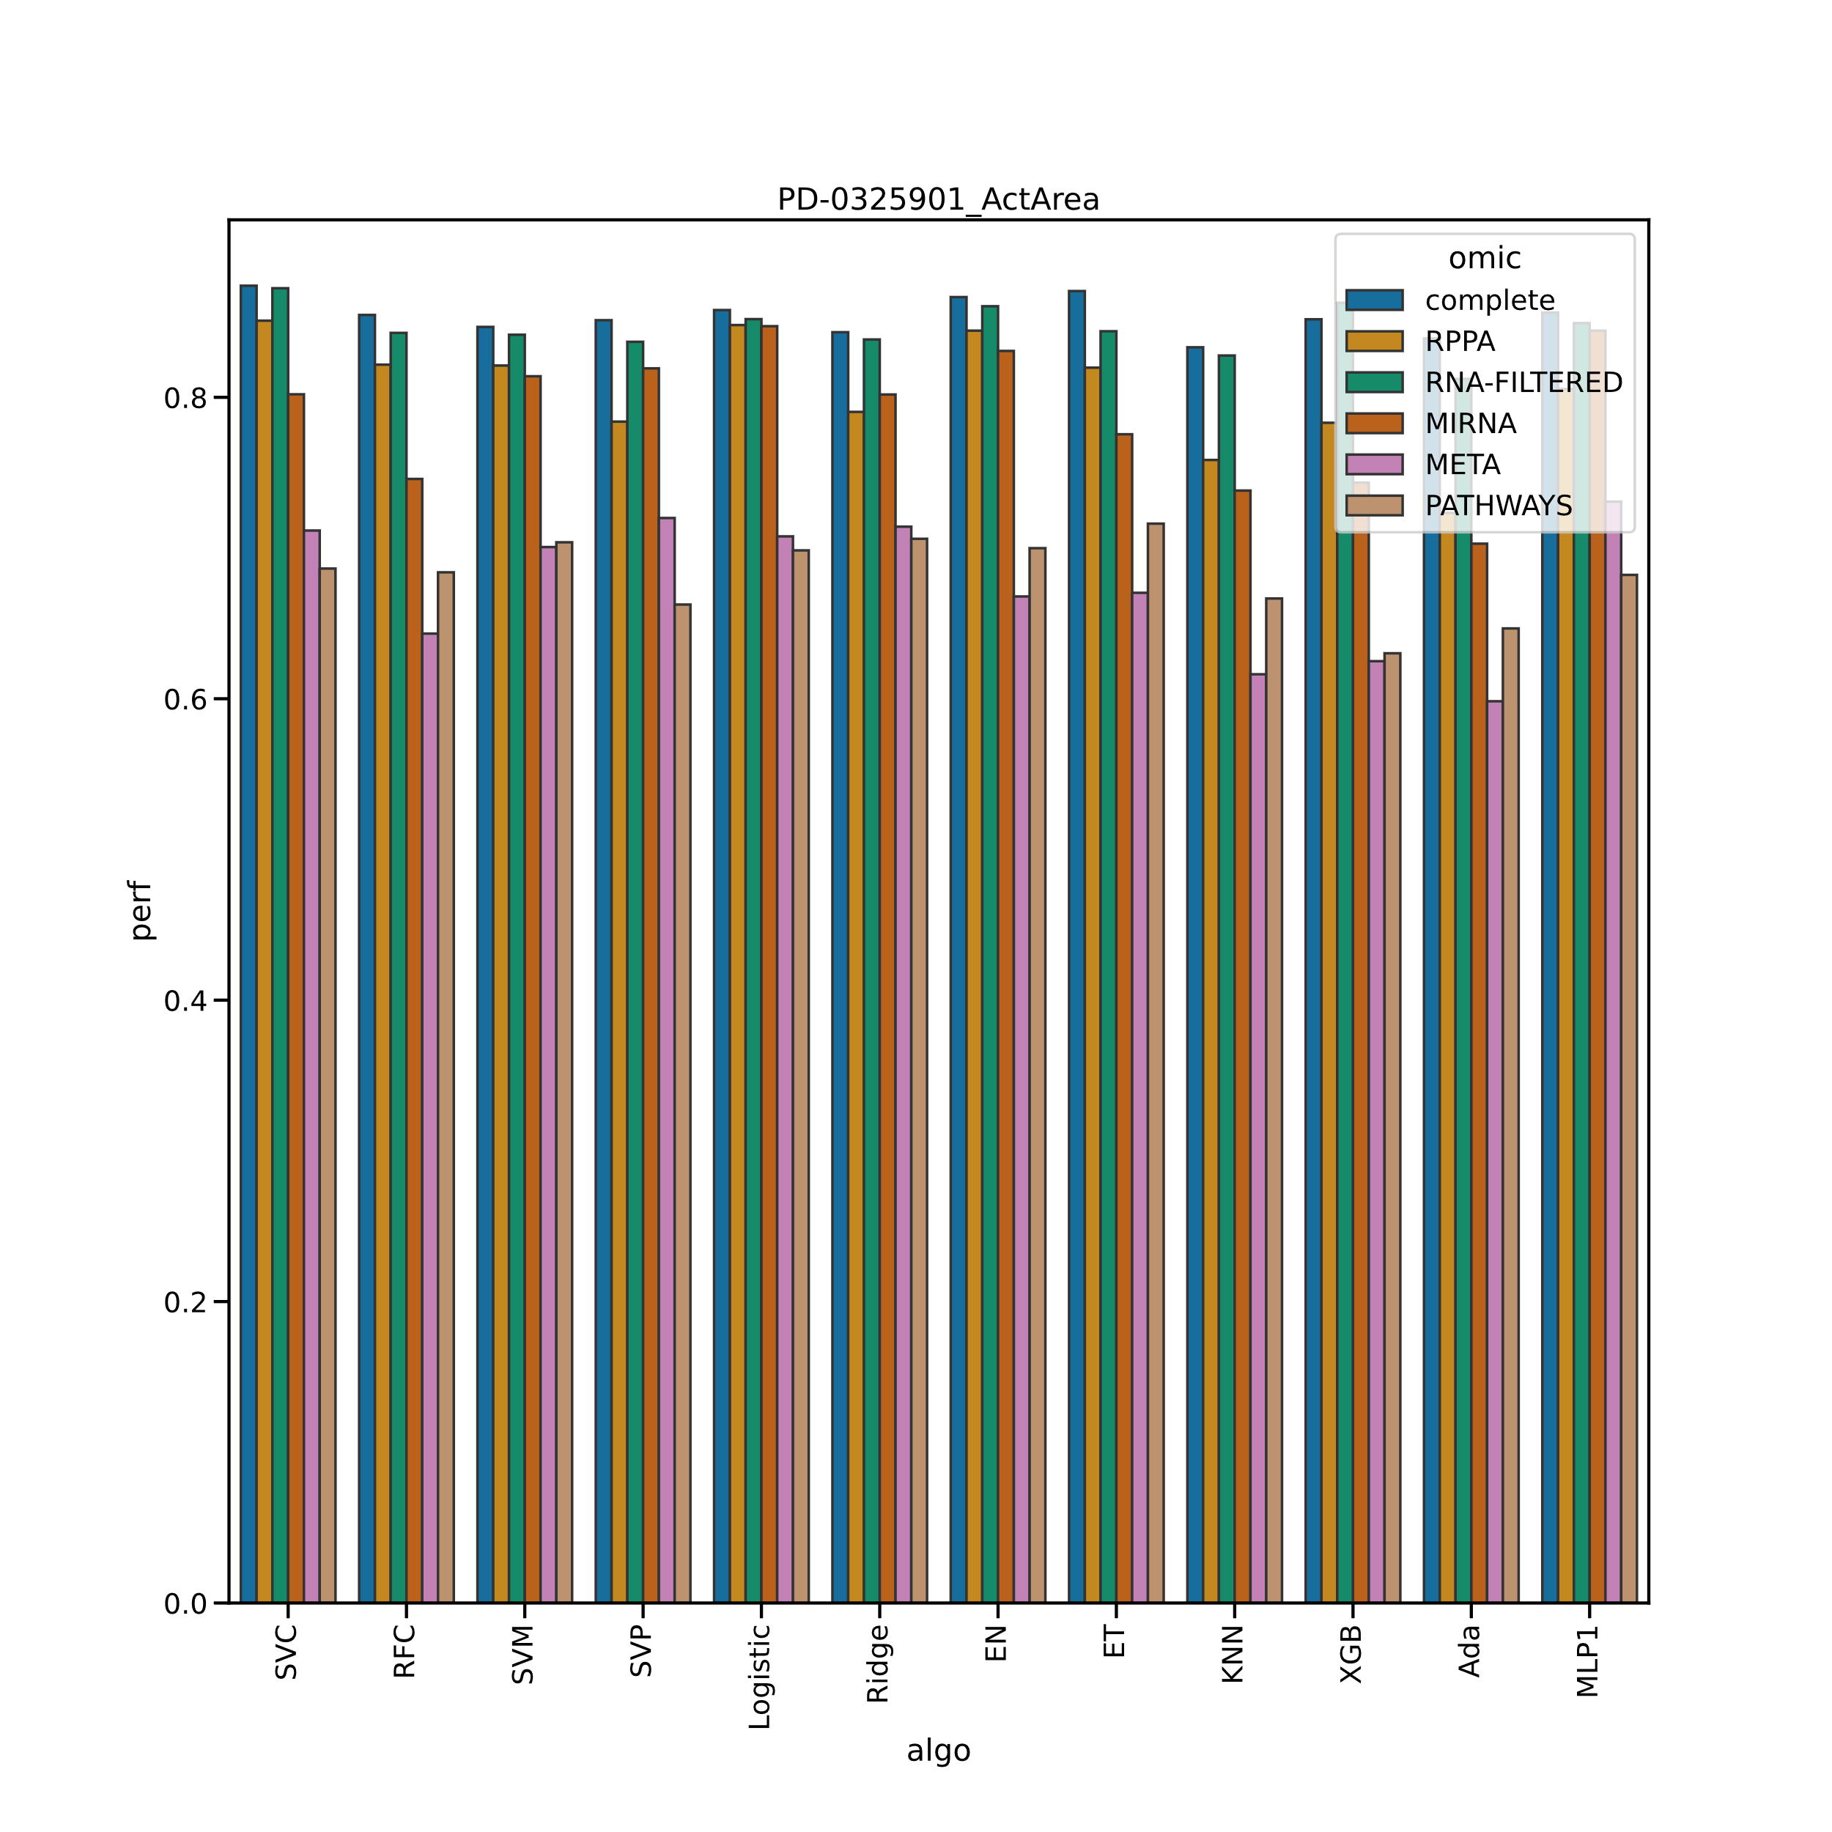

Slide 11
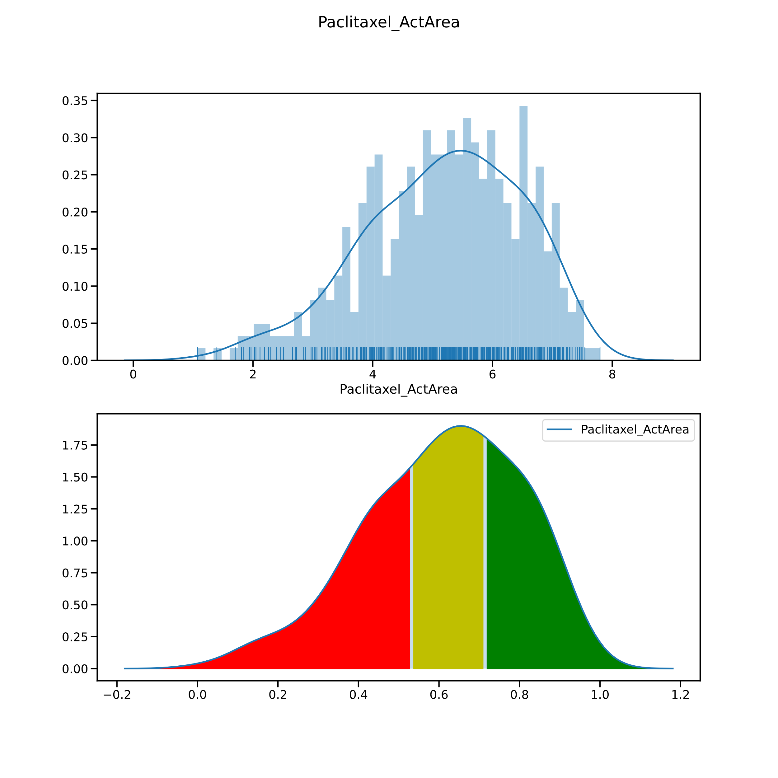
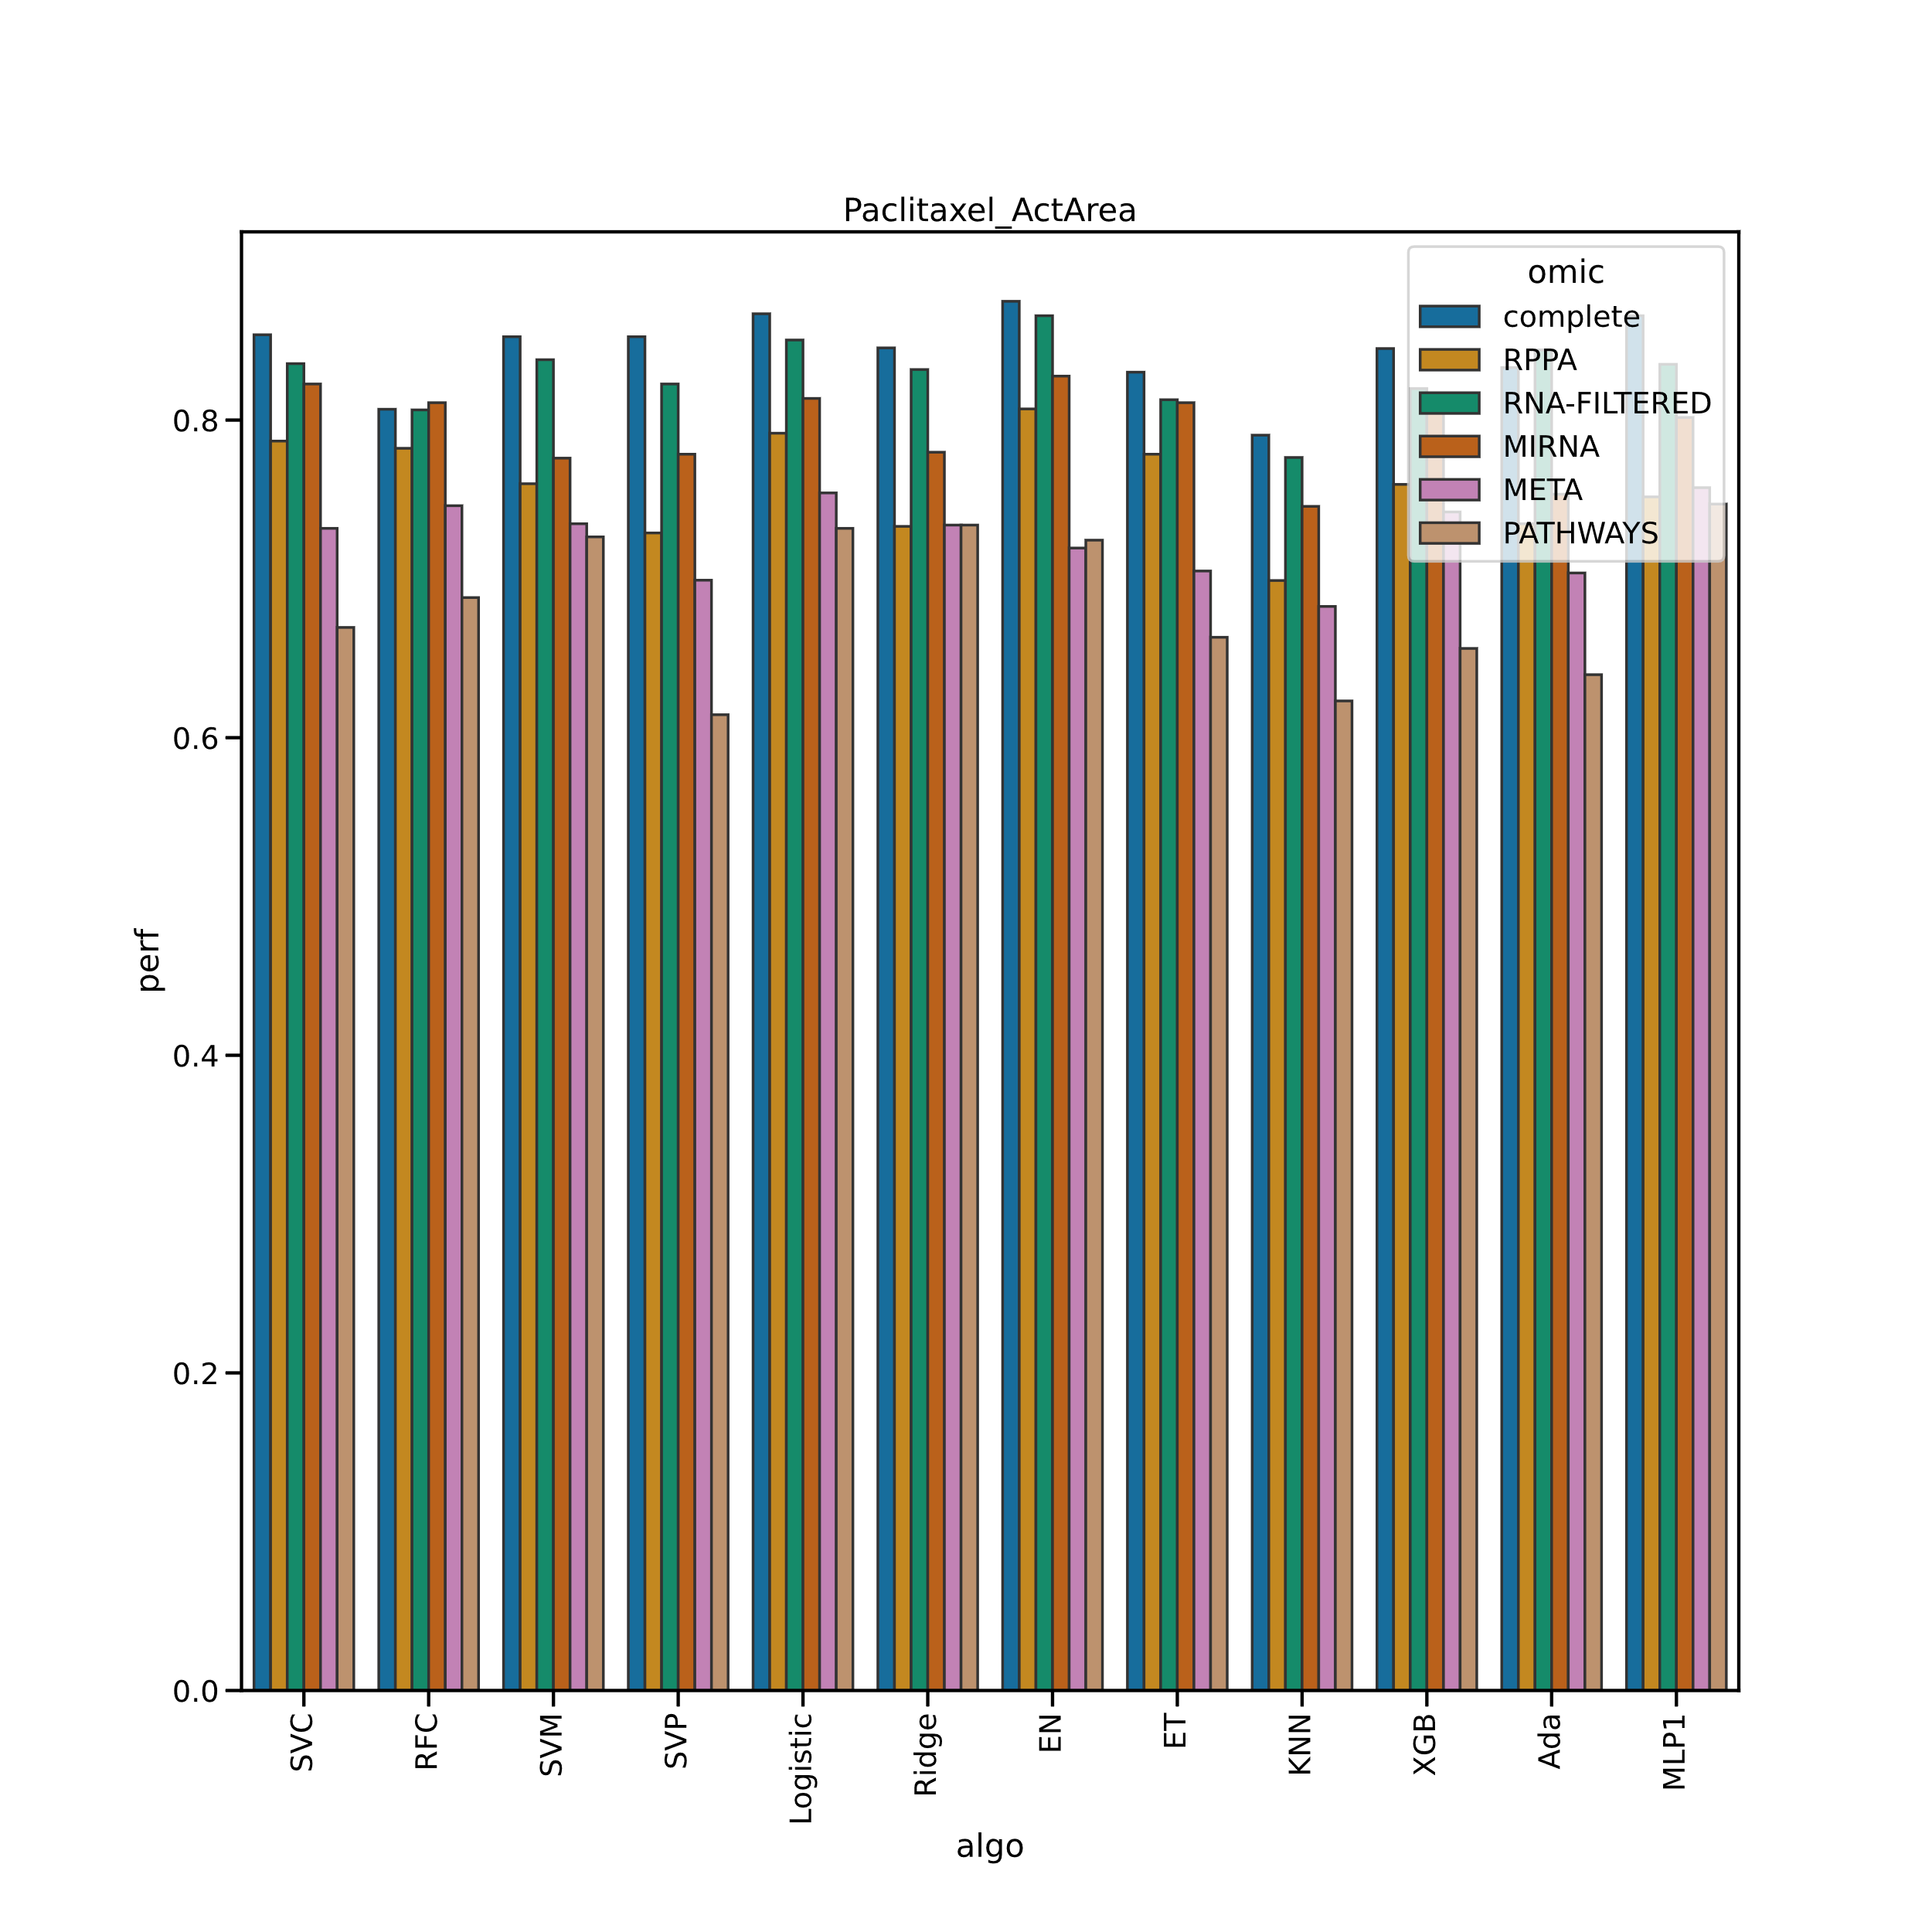

Slide 12
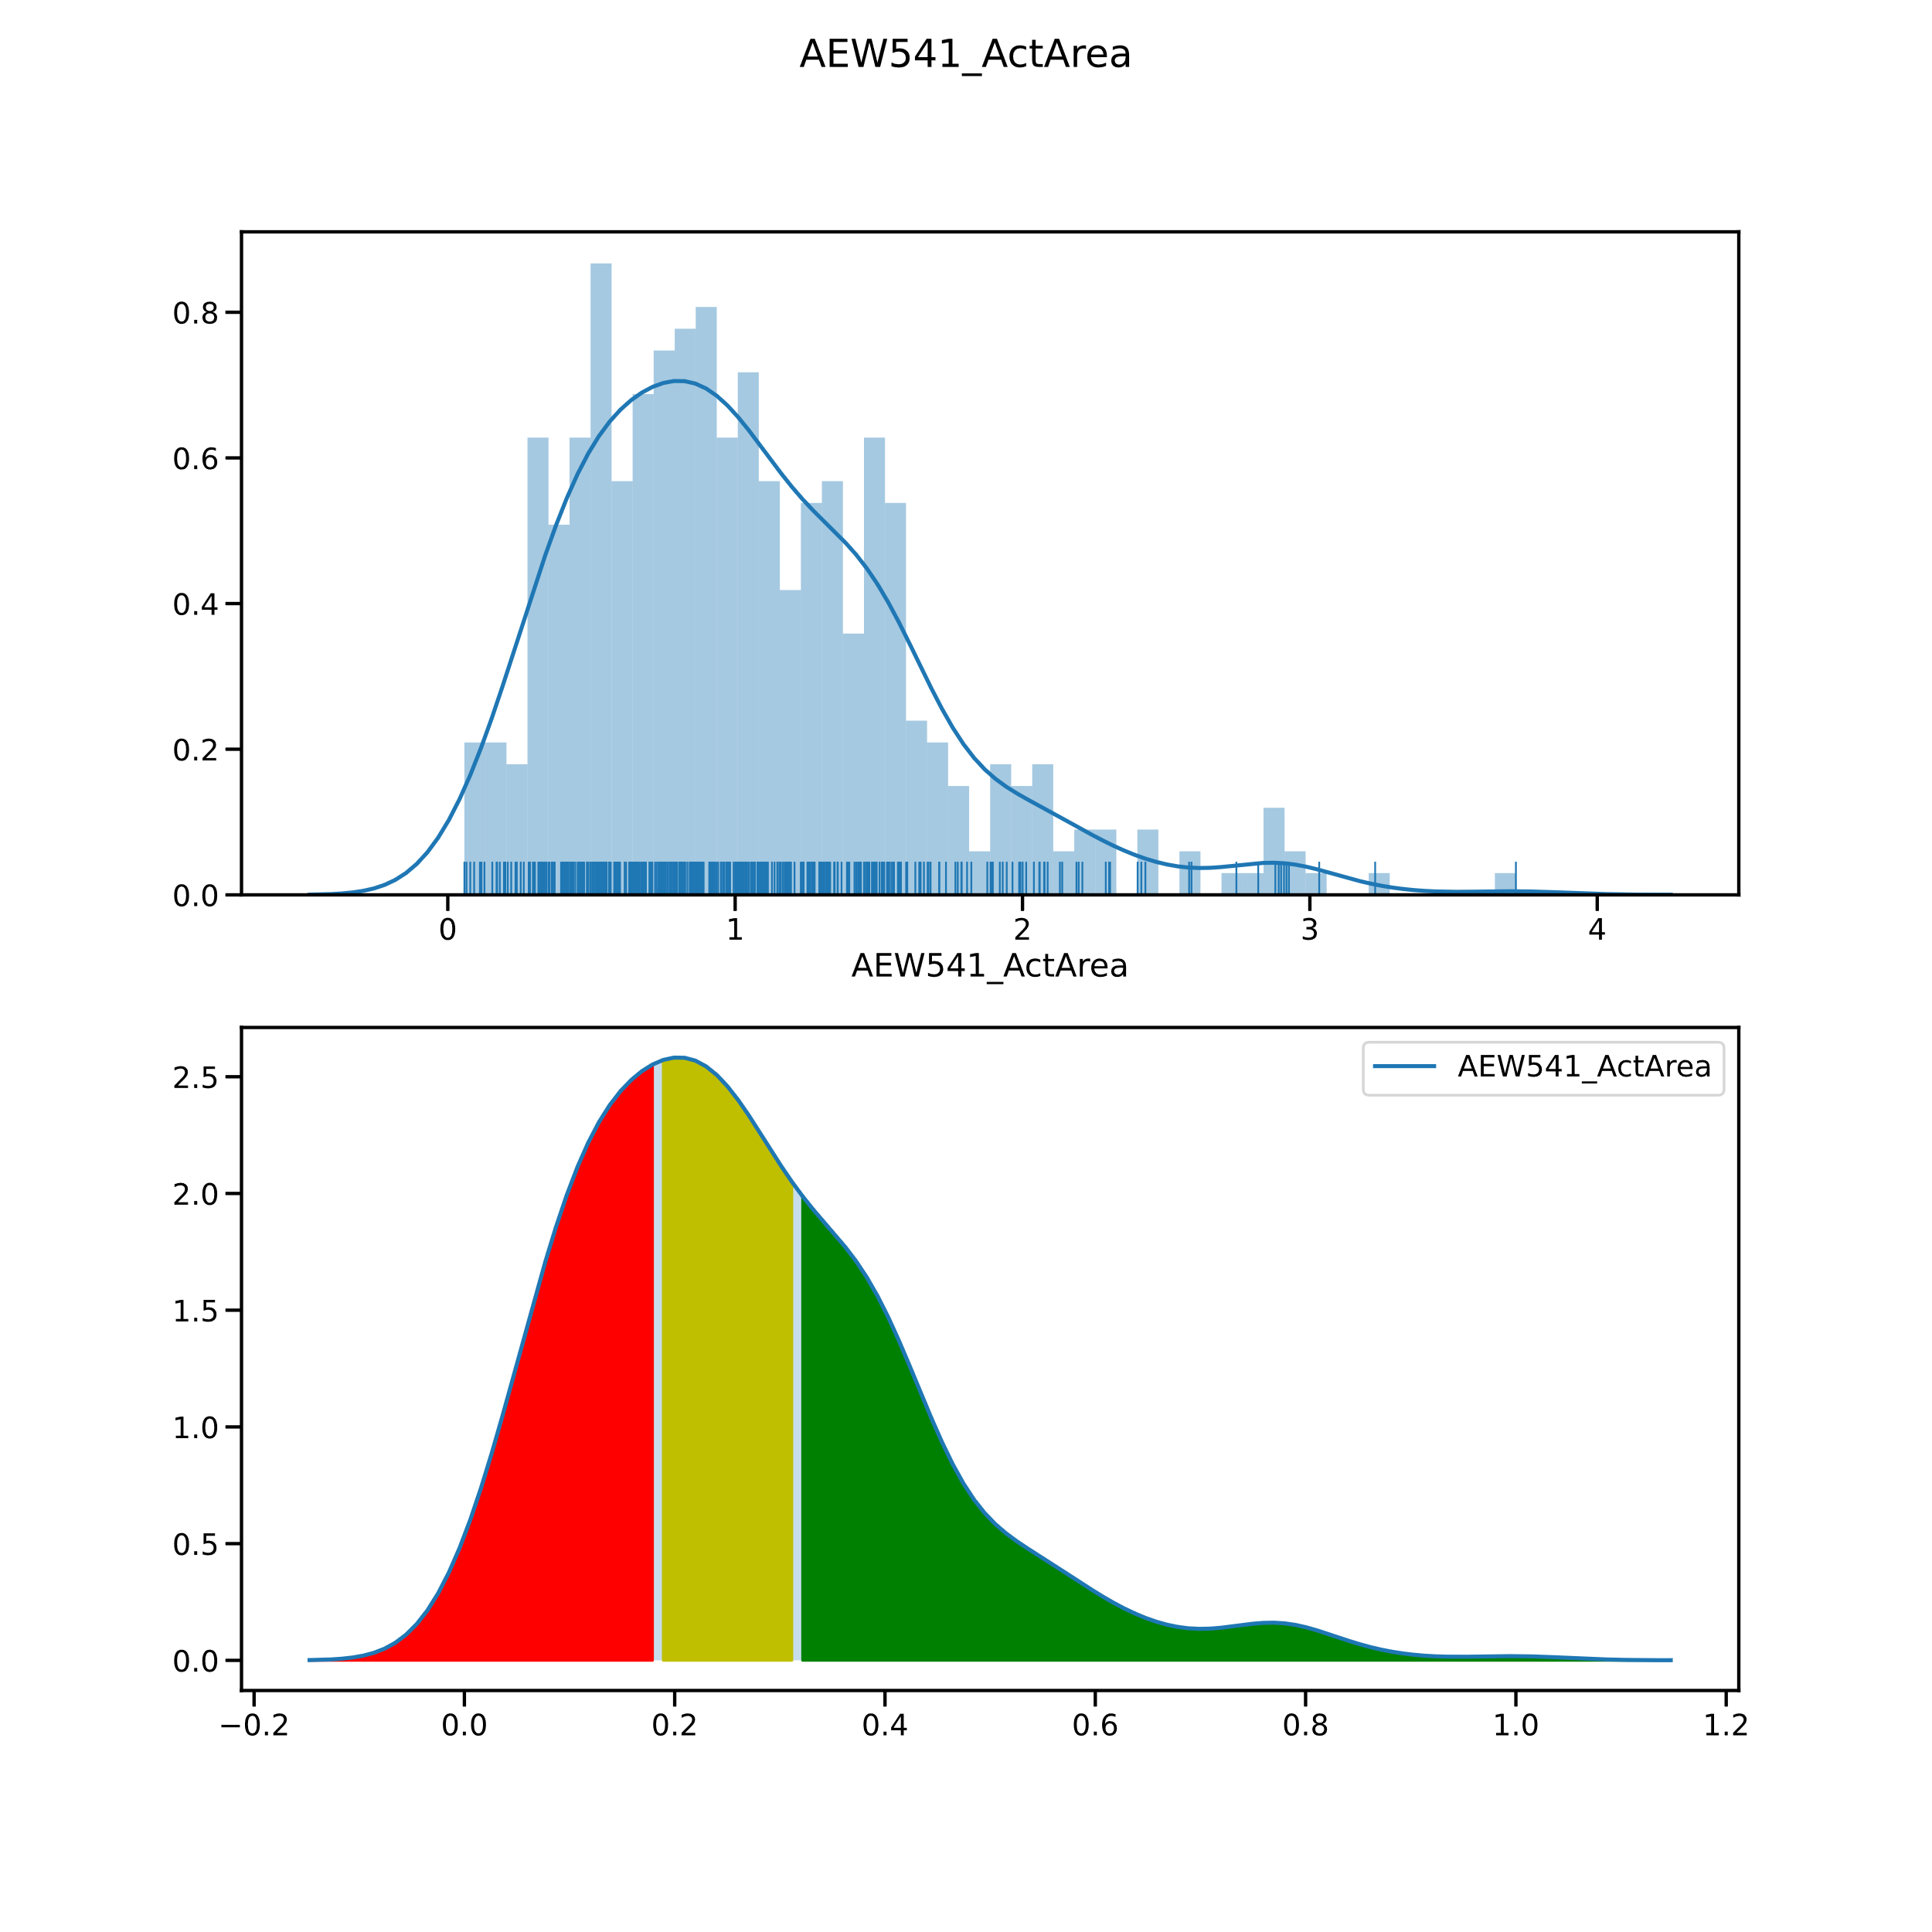

Slide 13
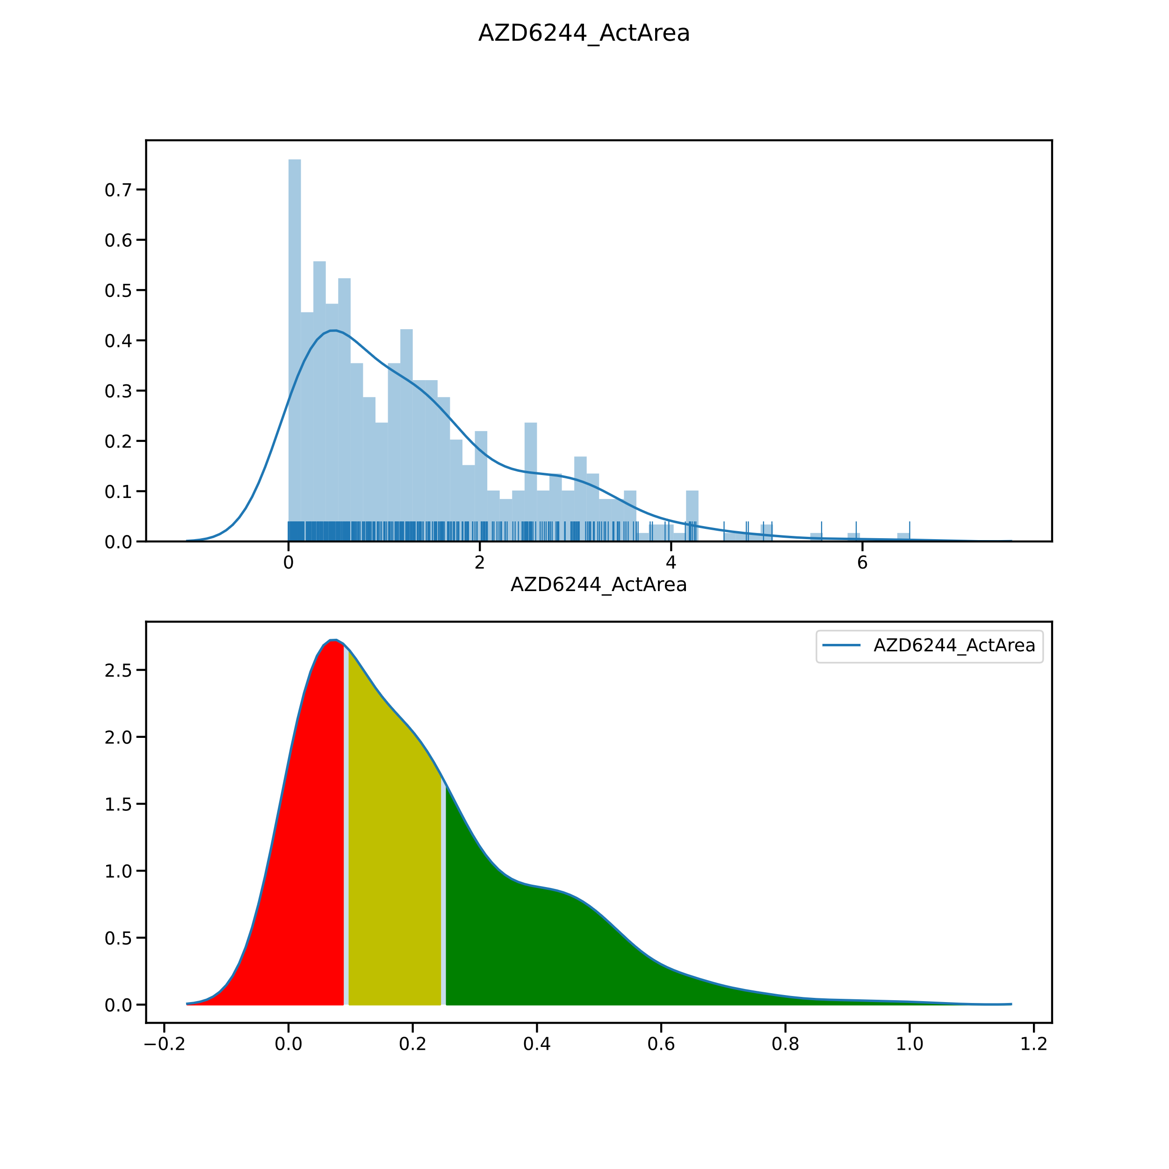

Slide 14
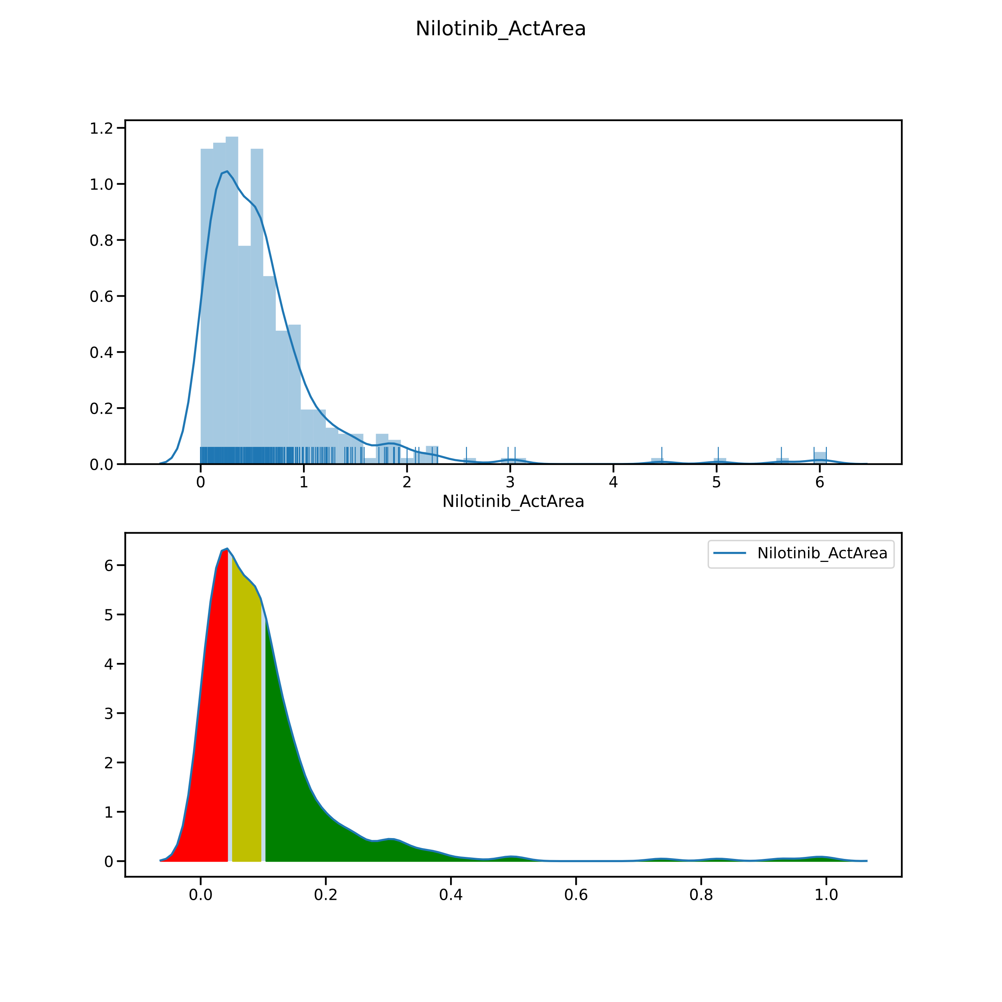

Slide 15
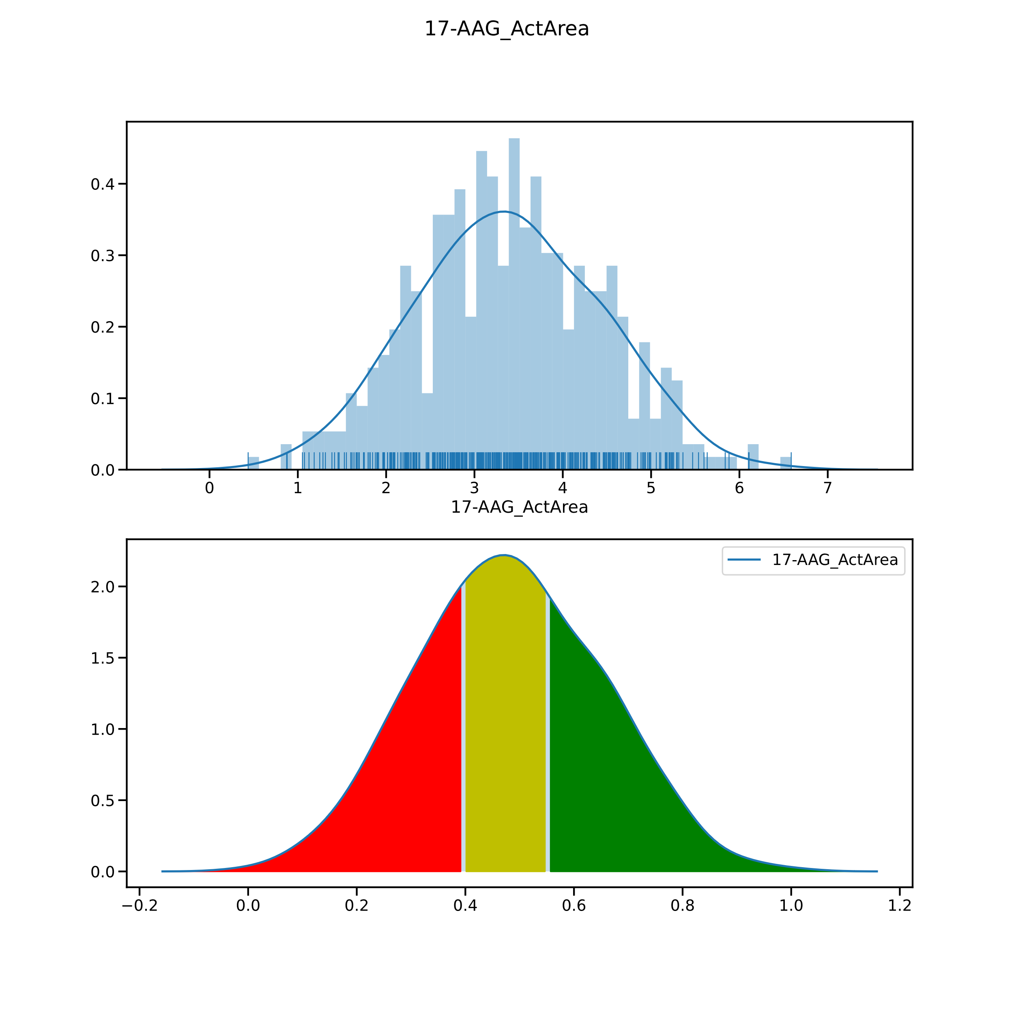

Slide 16
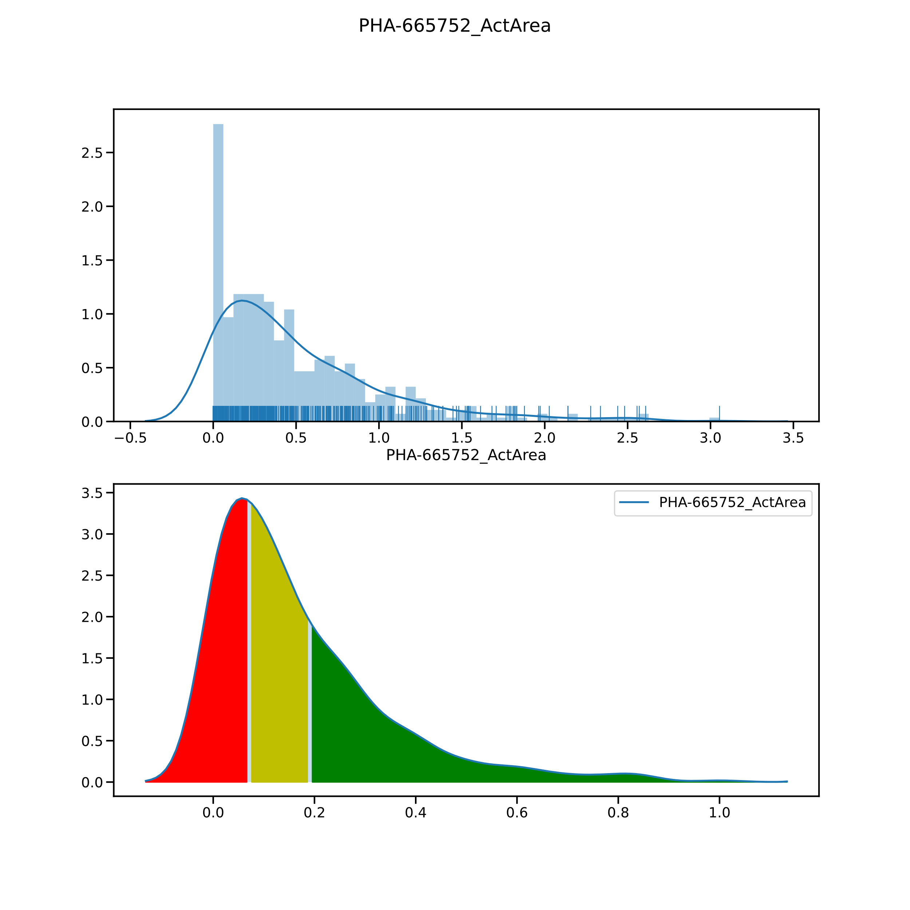

Slide 17
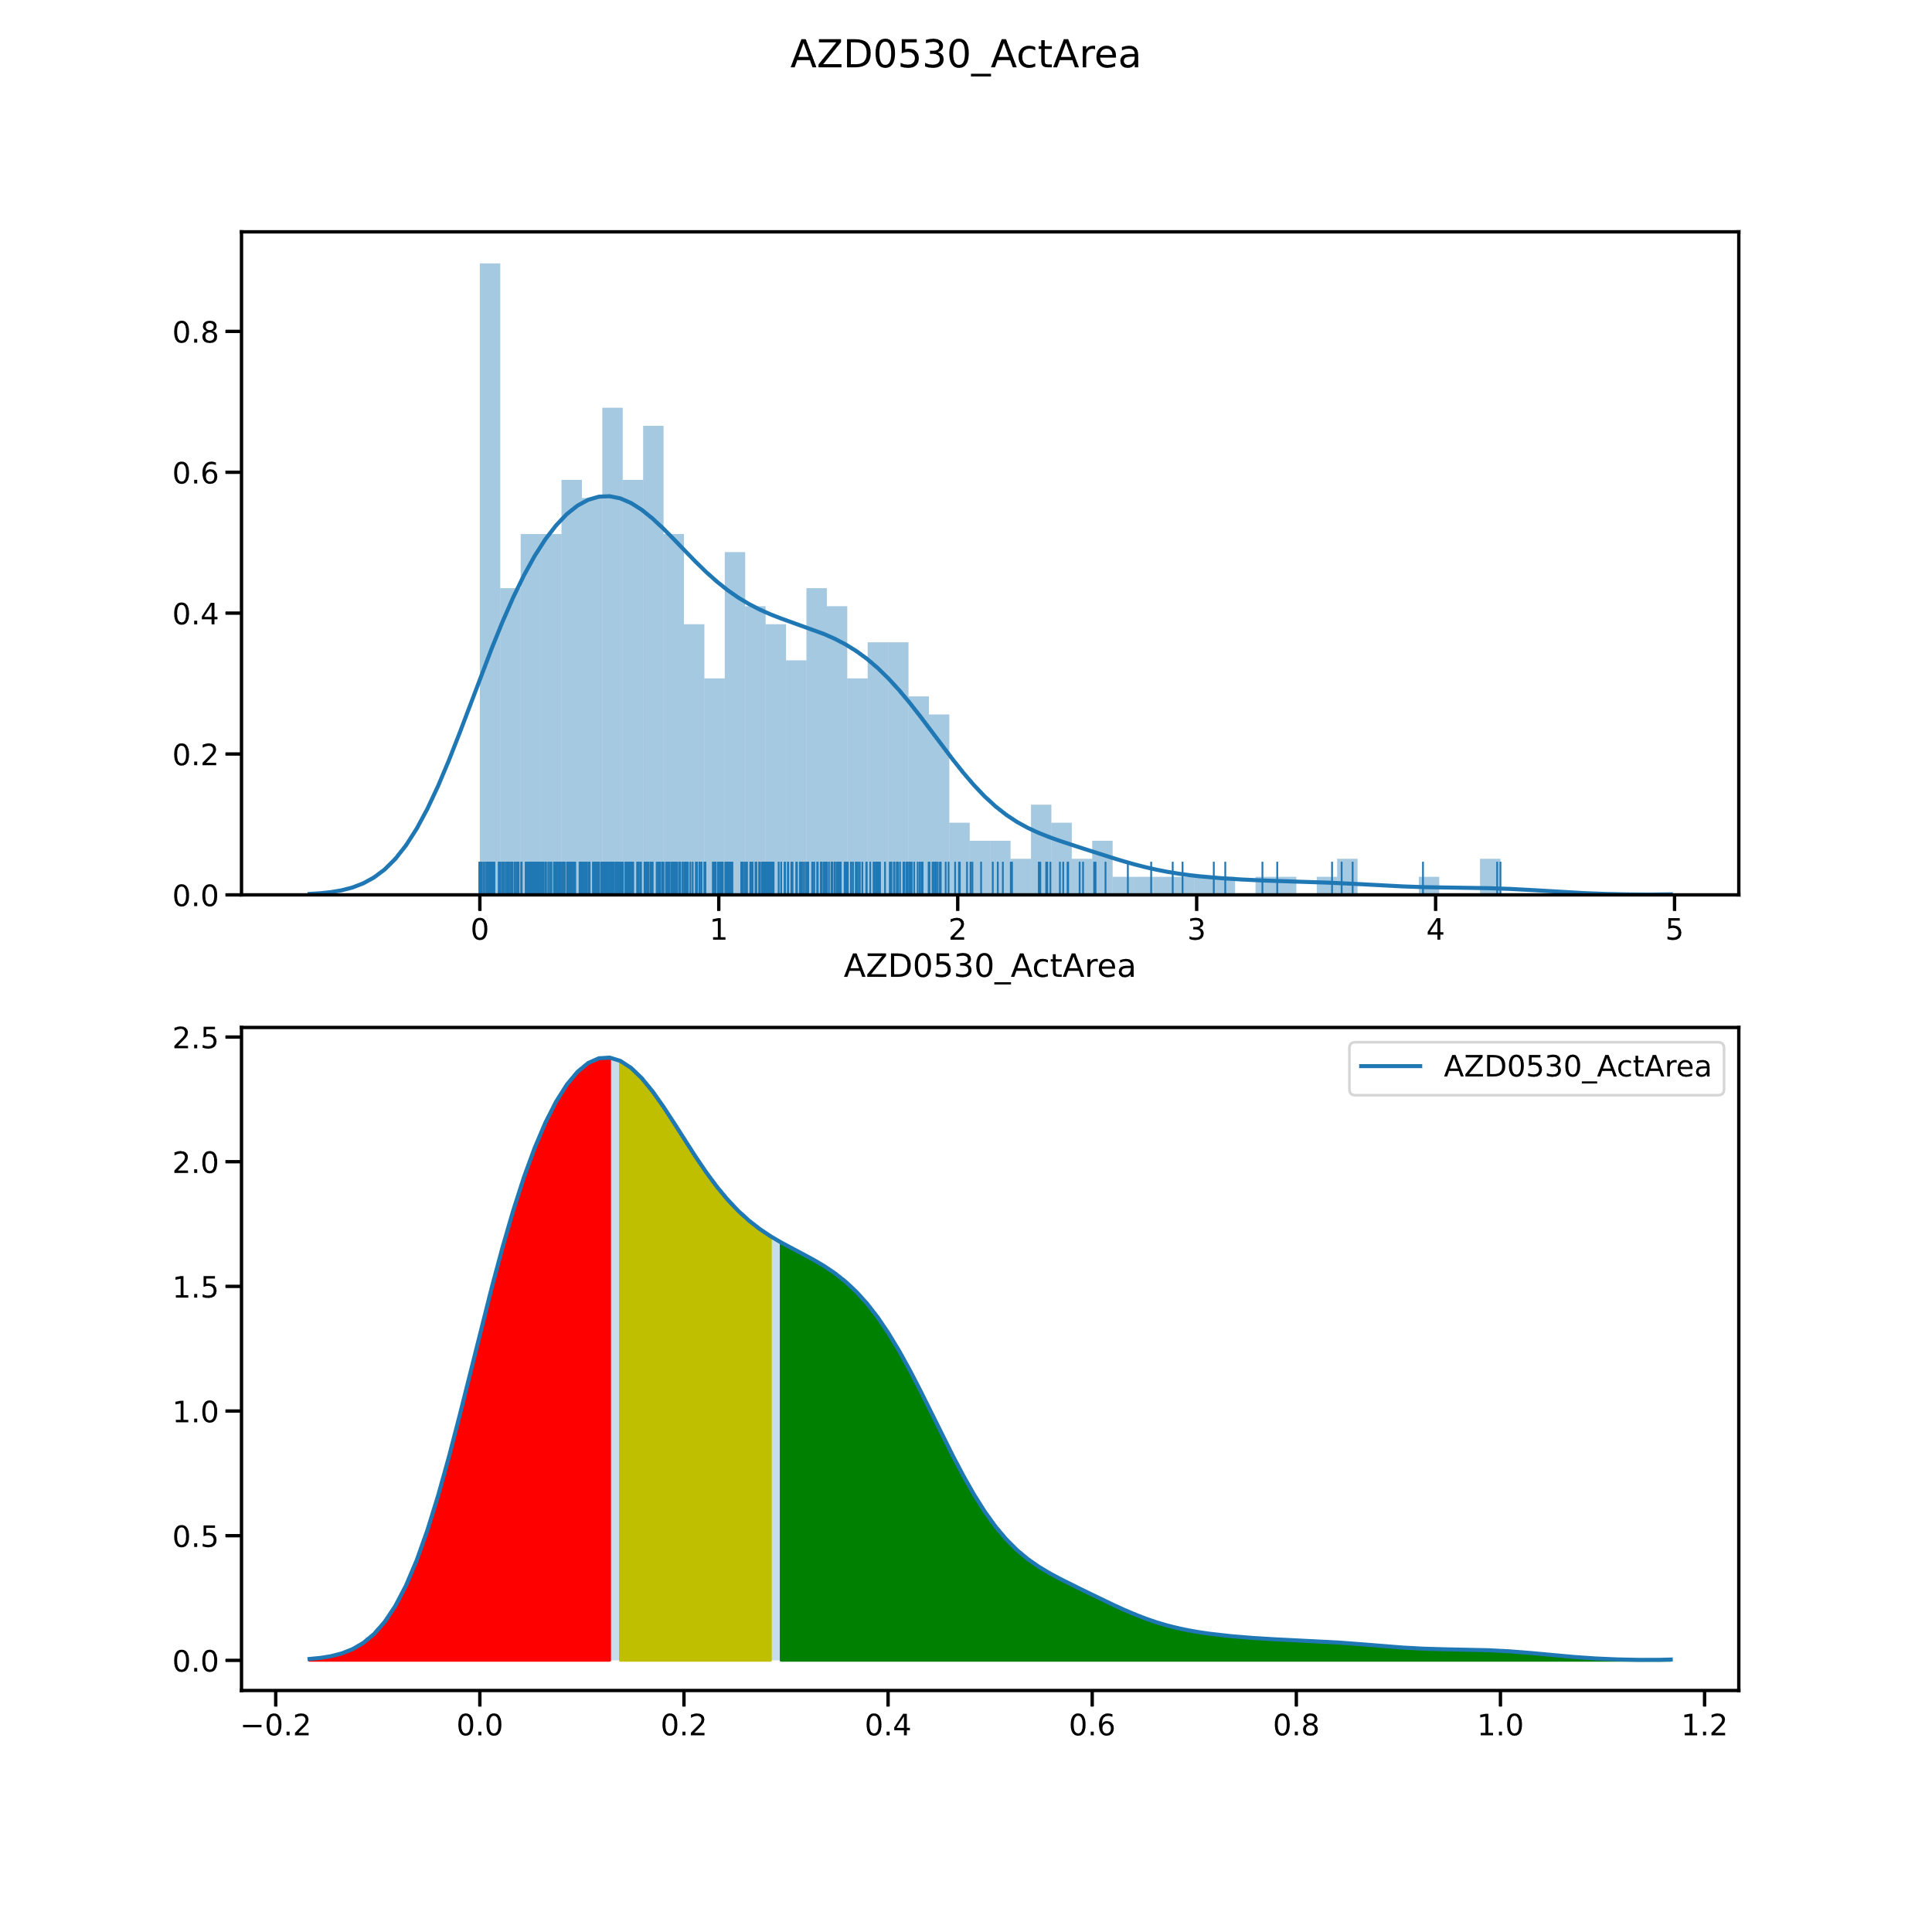

Slide 18
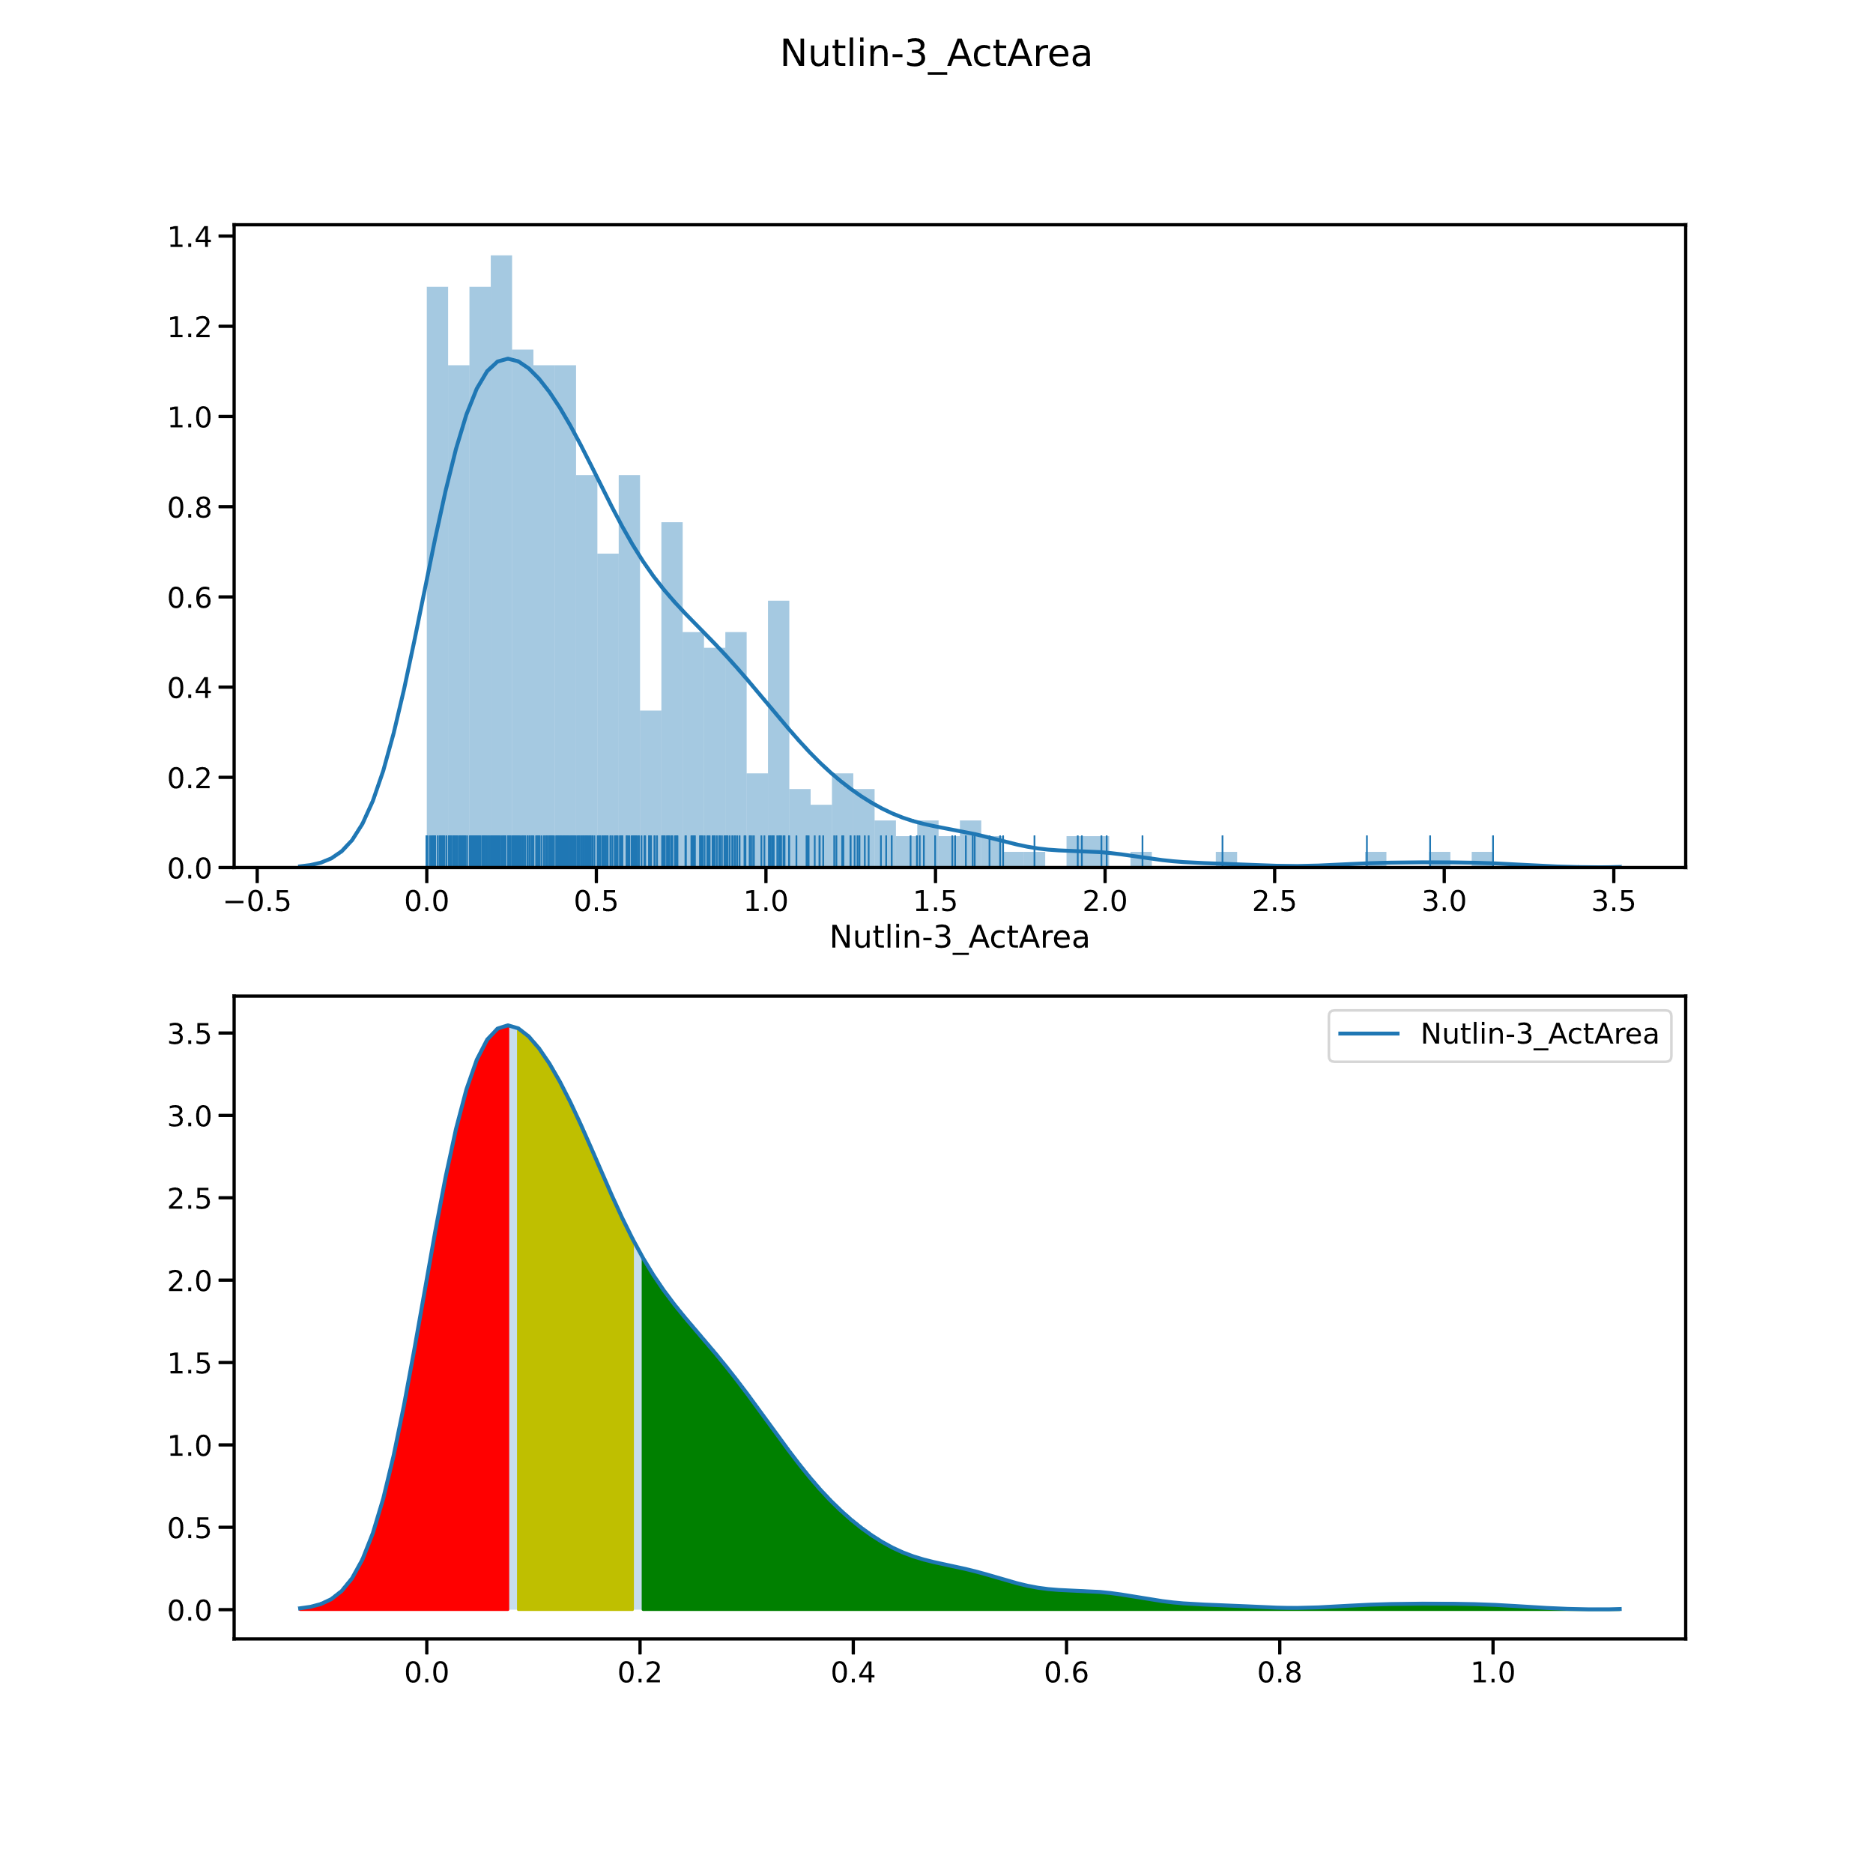

Slide 19
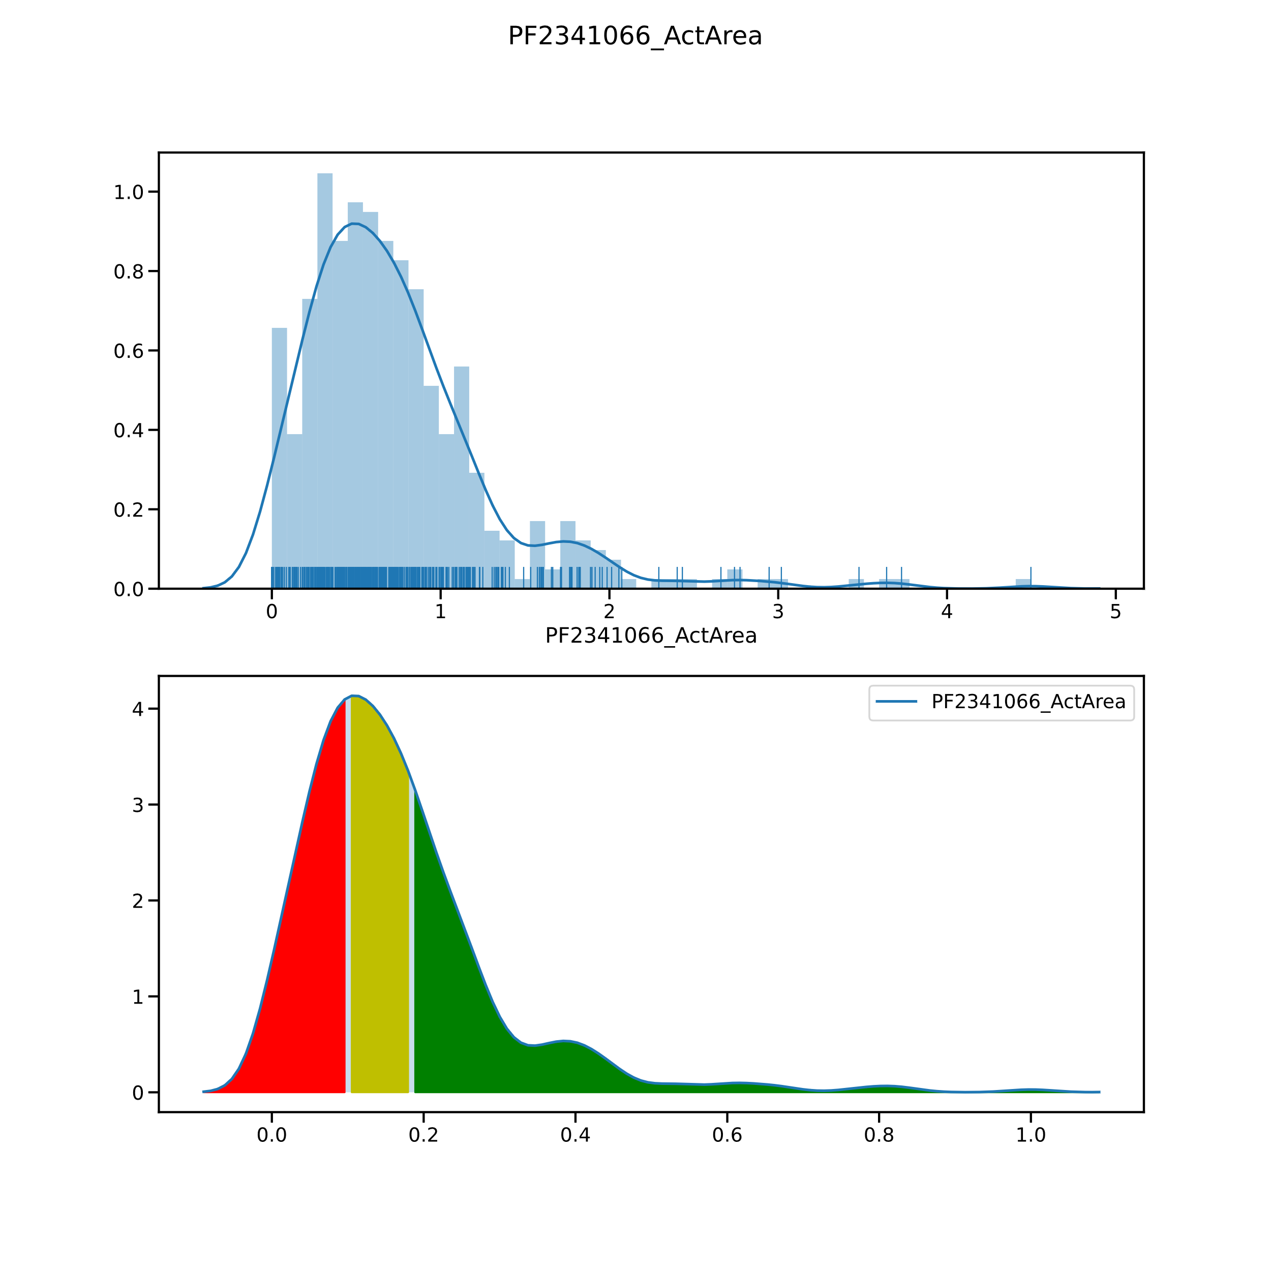

Slide 20
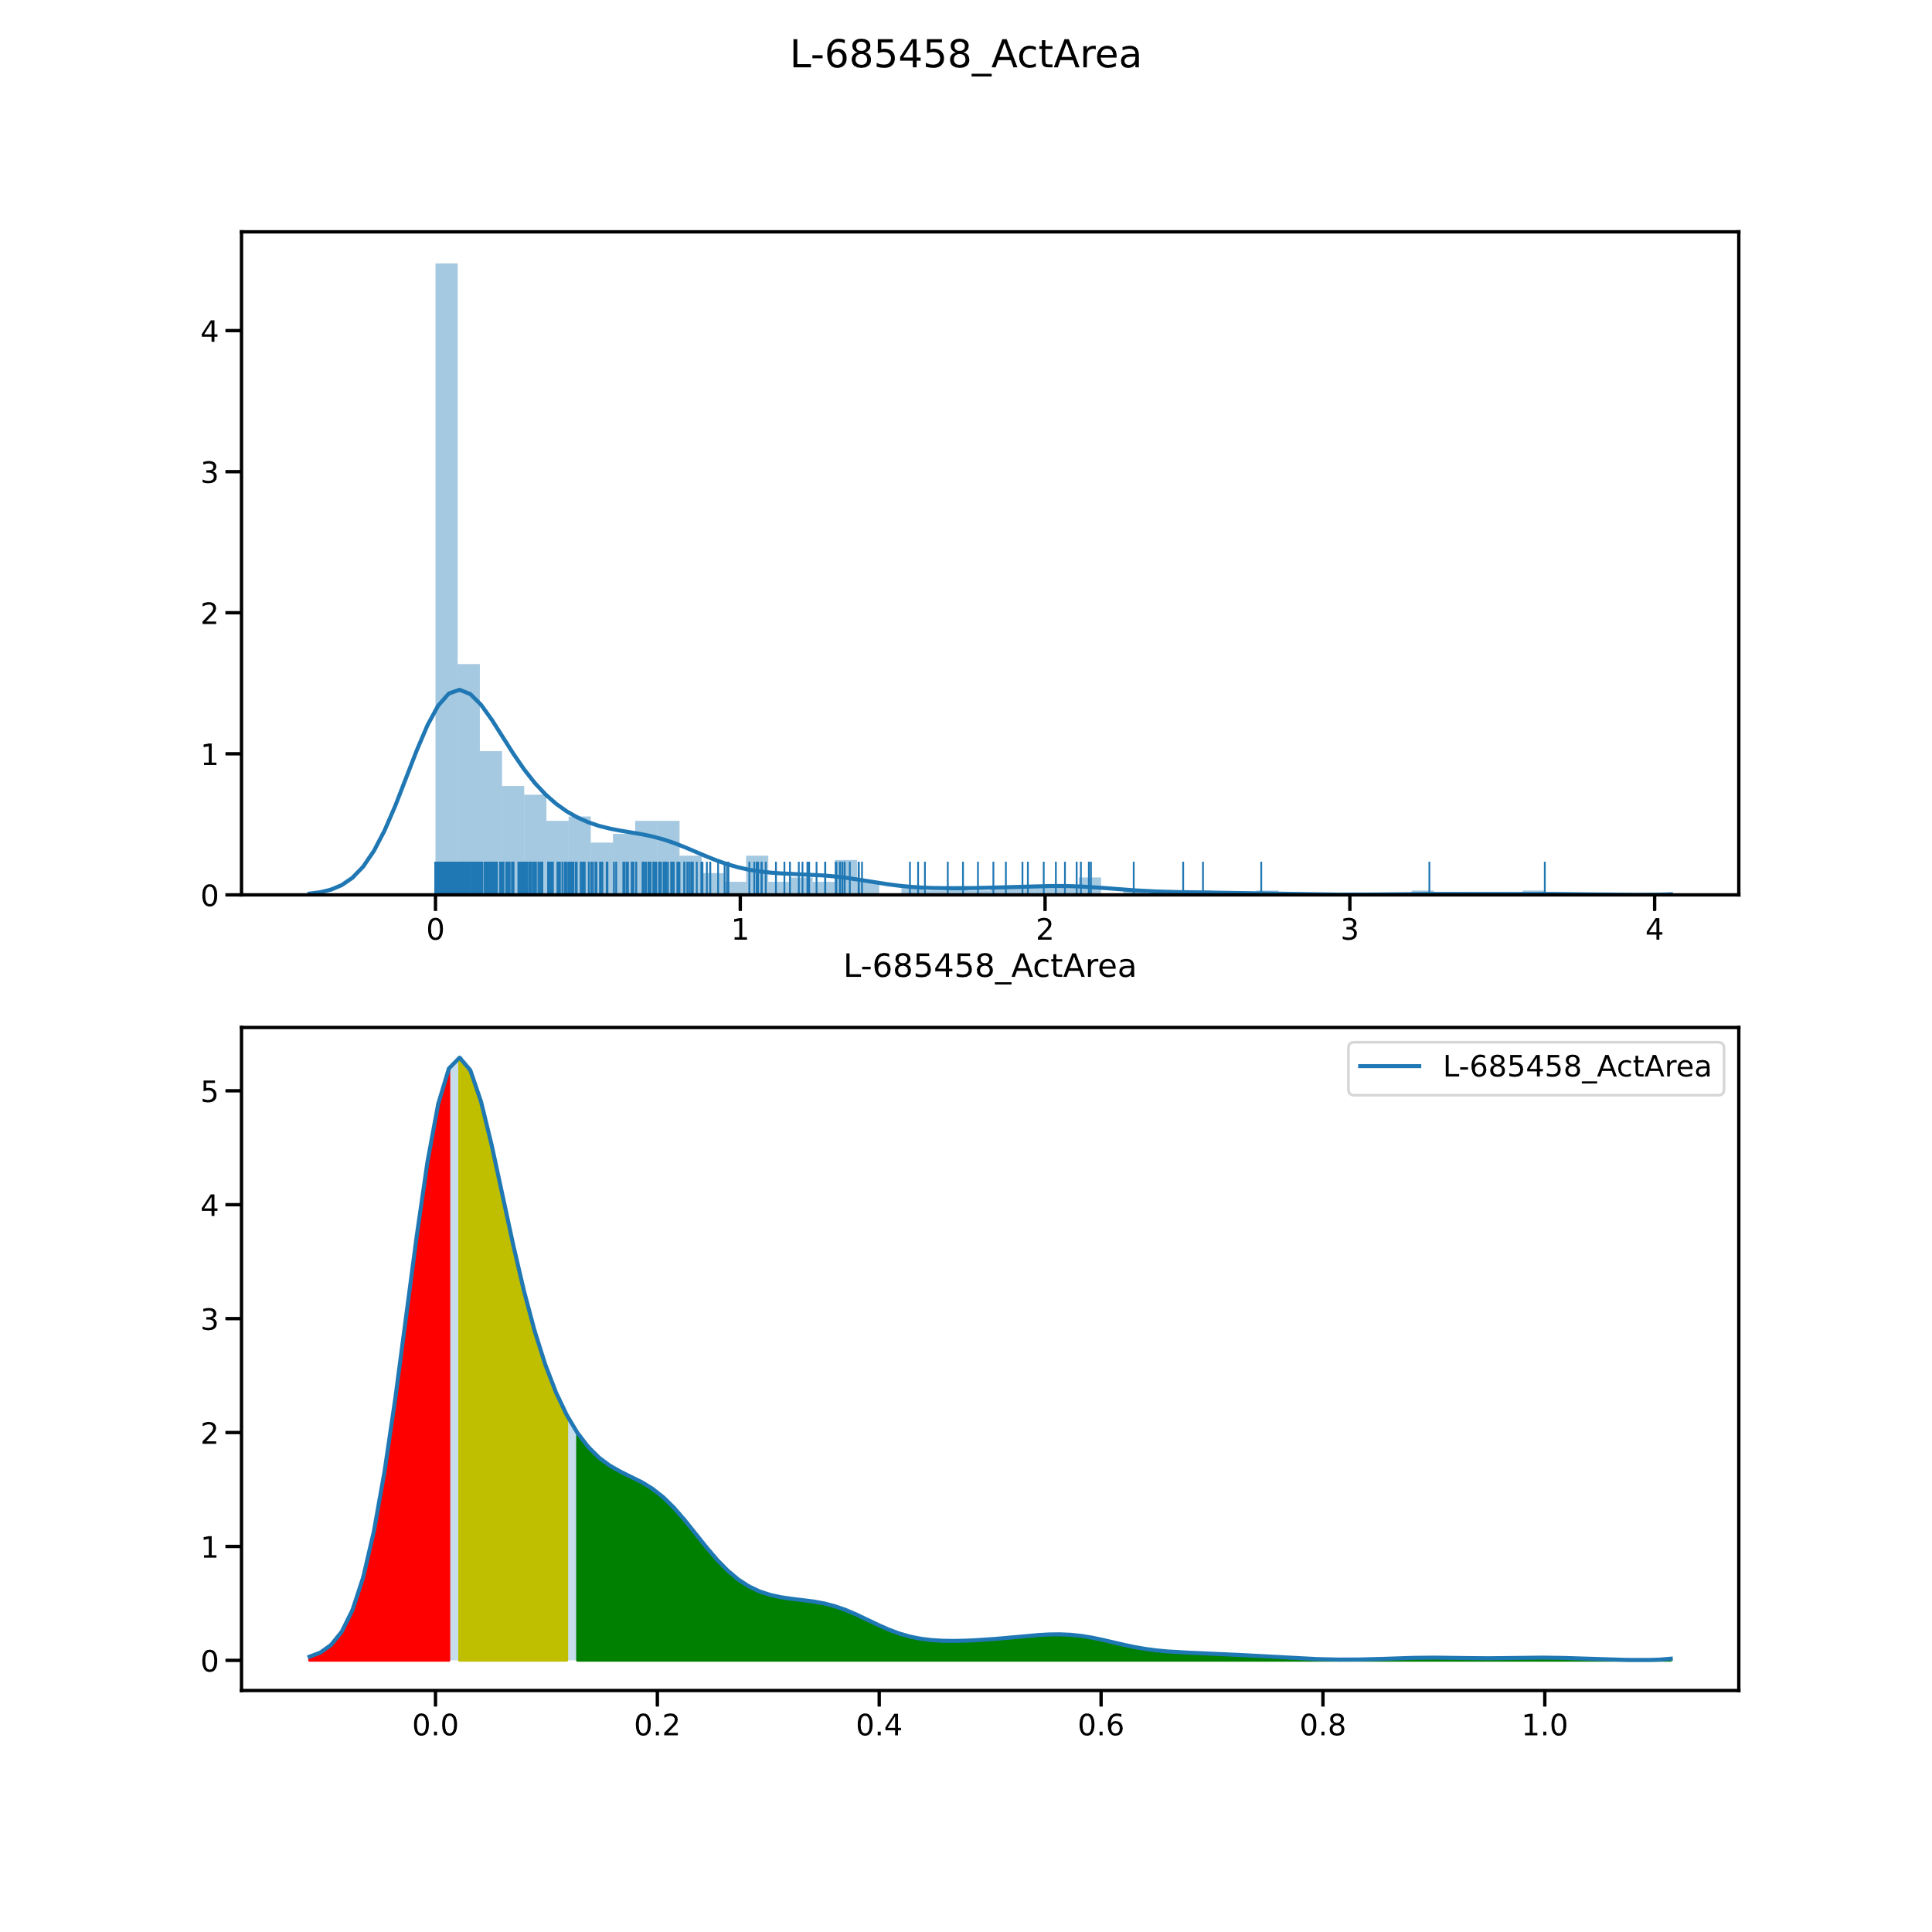

Slide 21
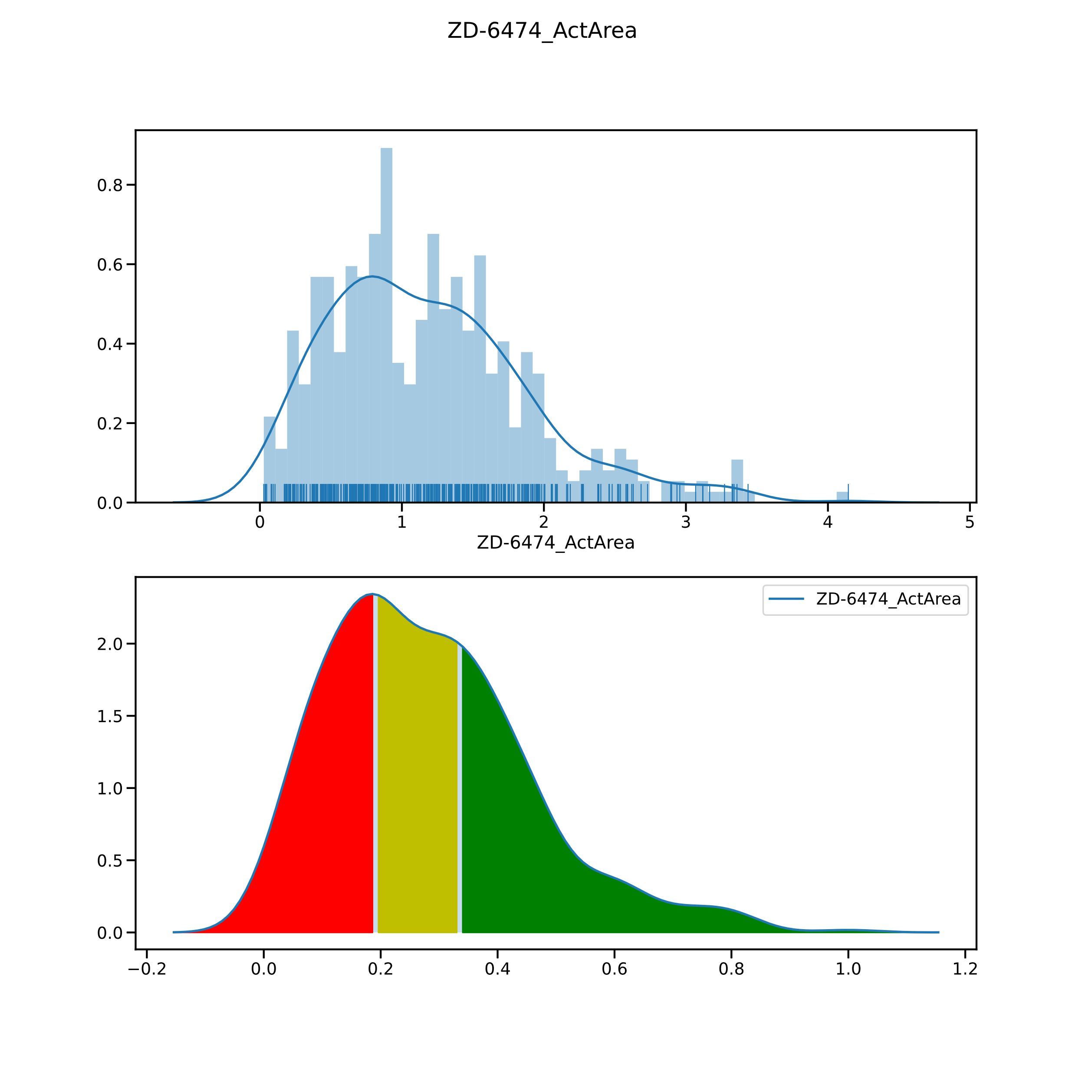

Slide 22
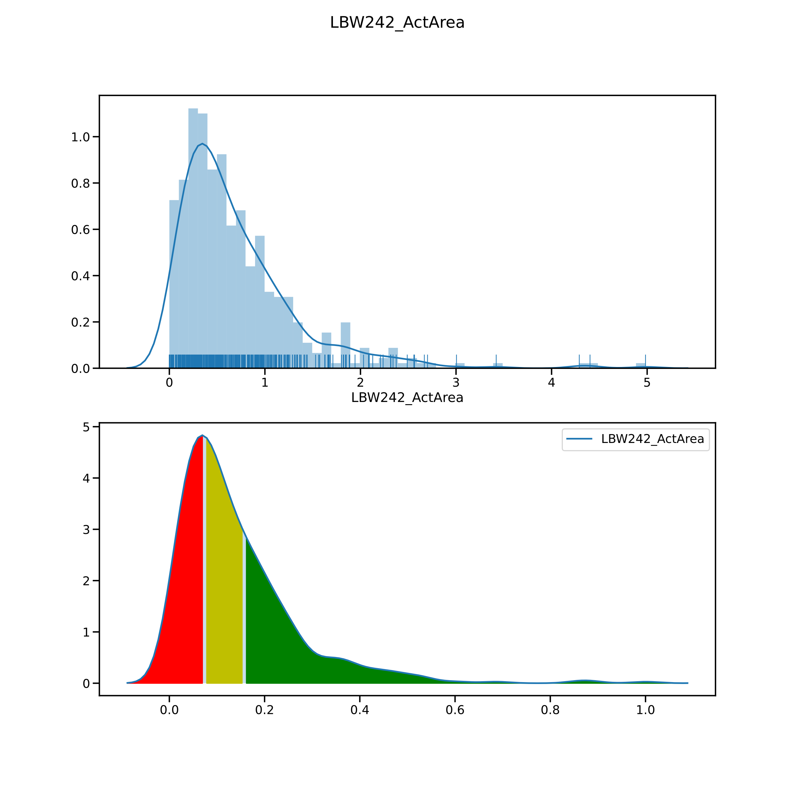

Slide 23
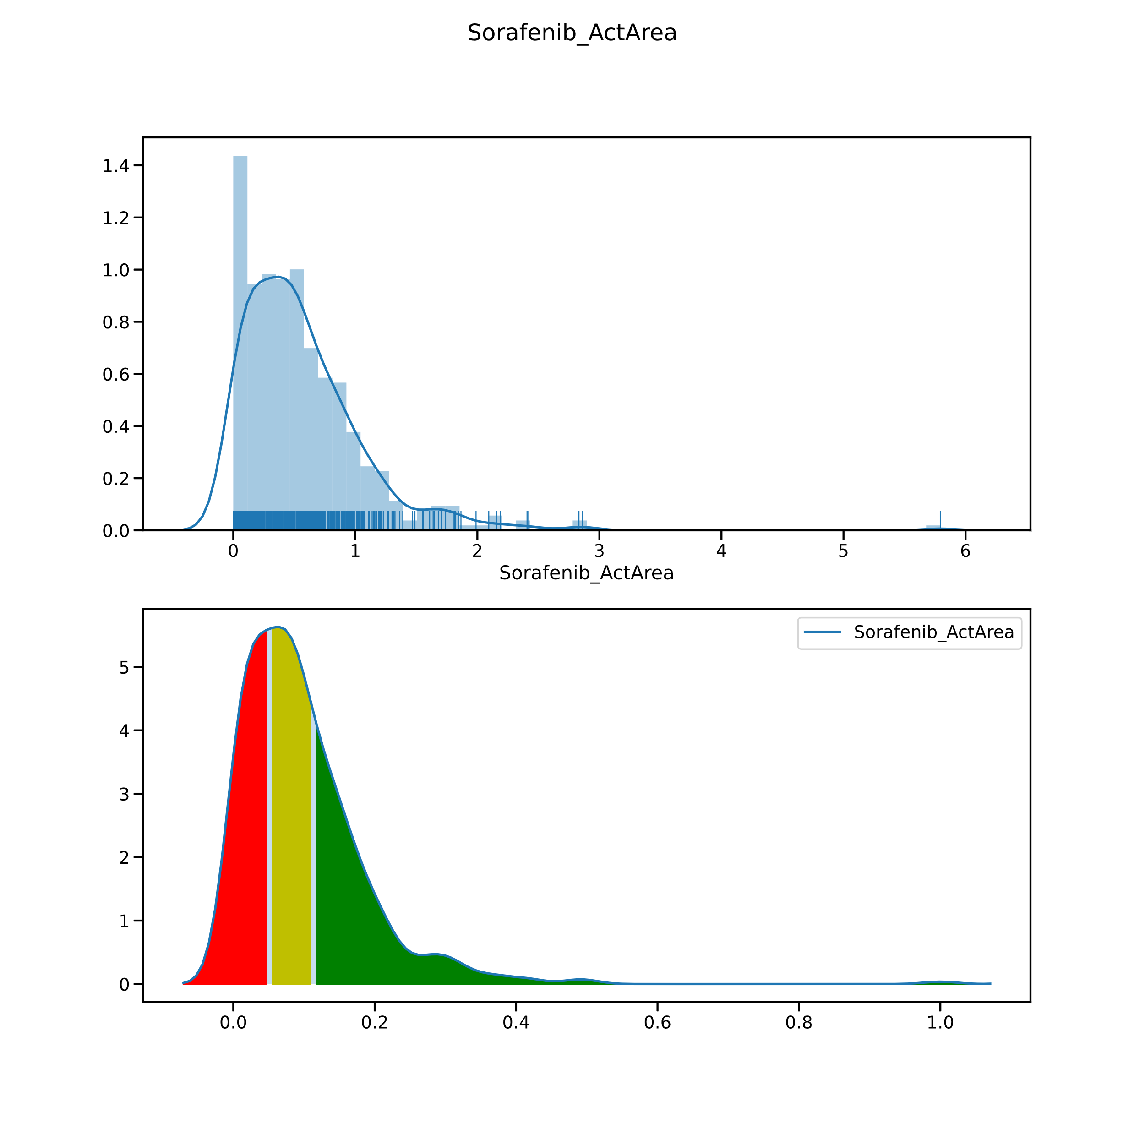

Slide 24
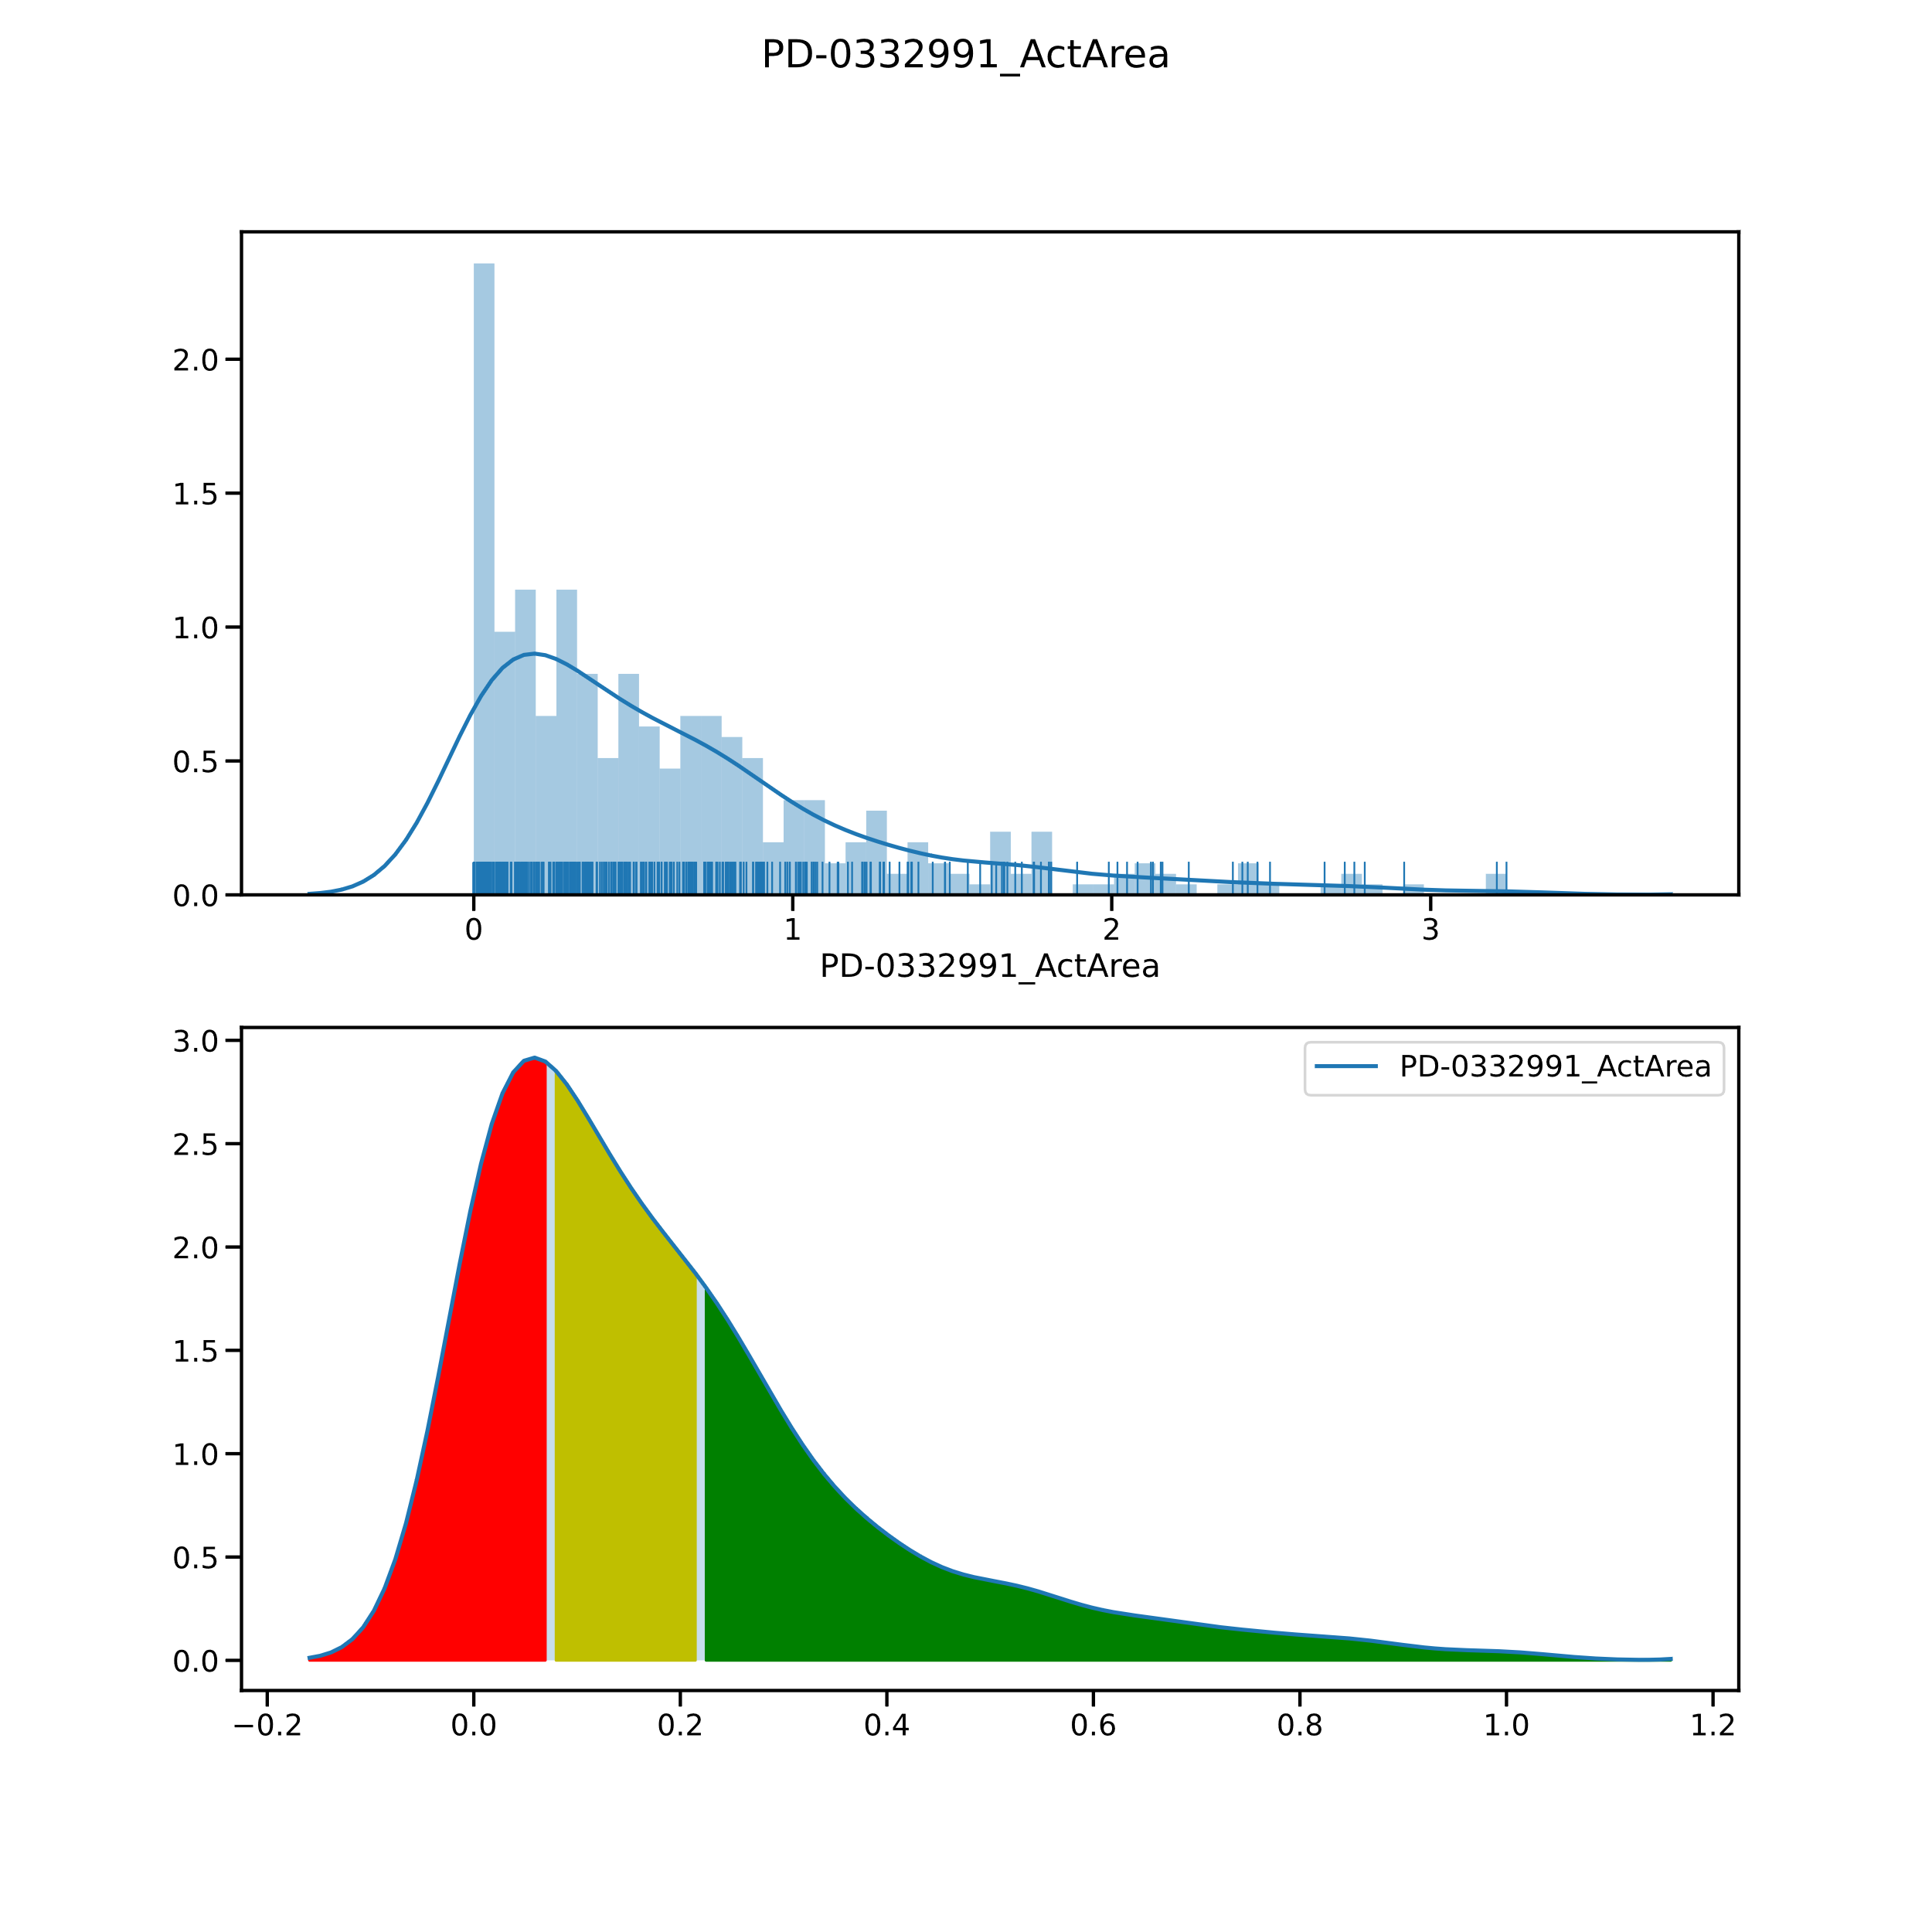

Slide 25
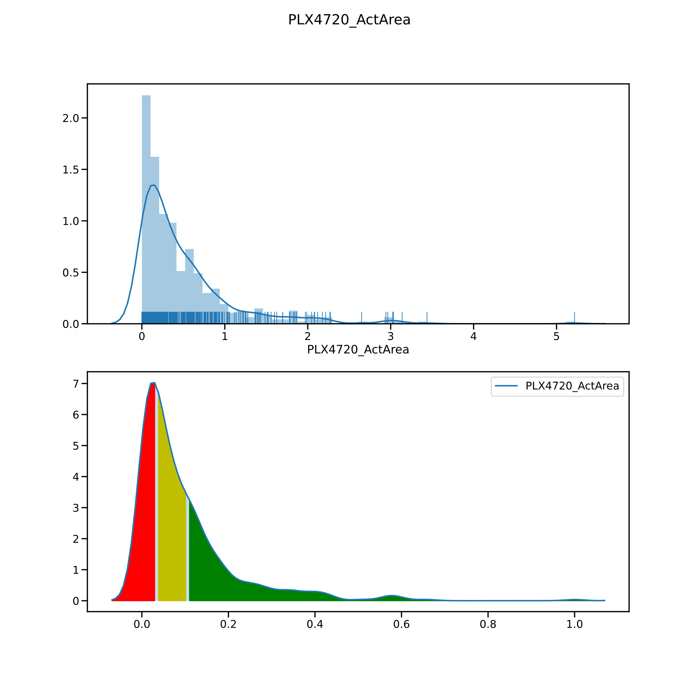

Slide 26
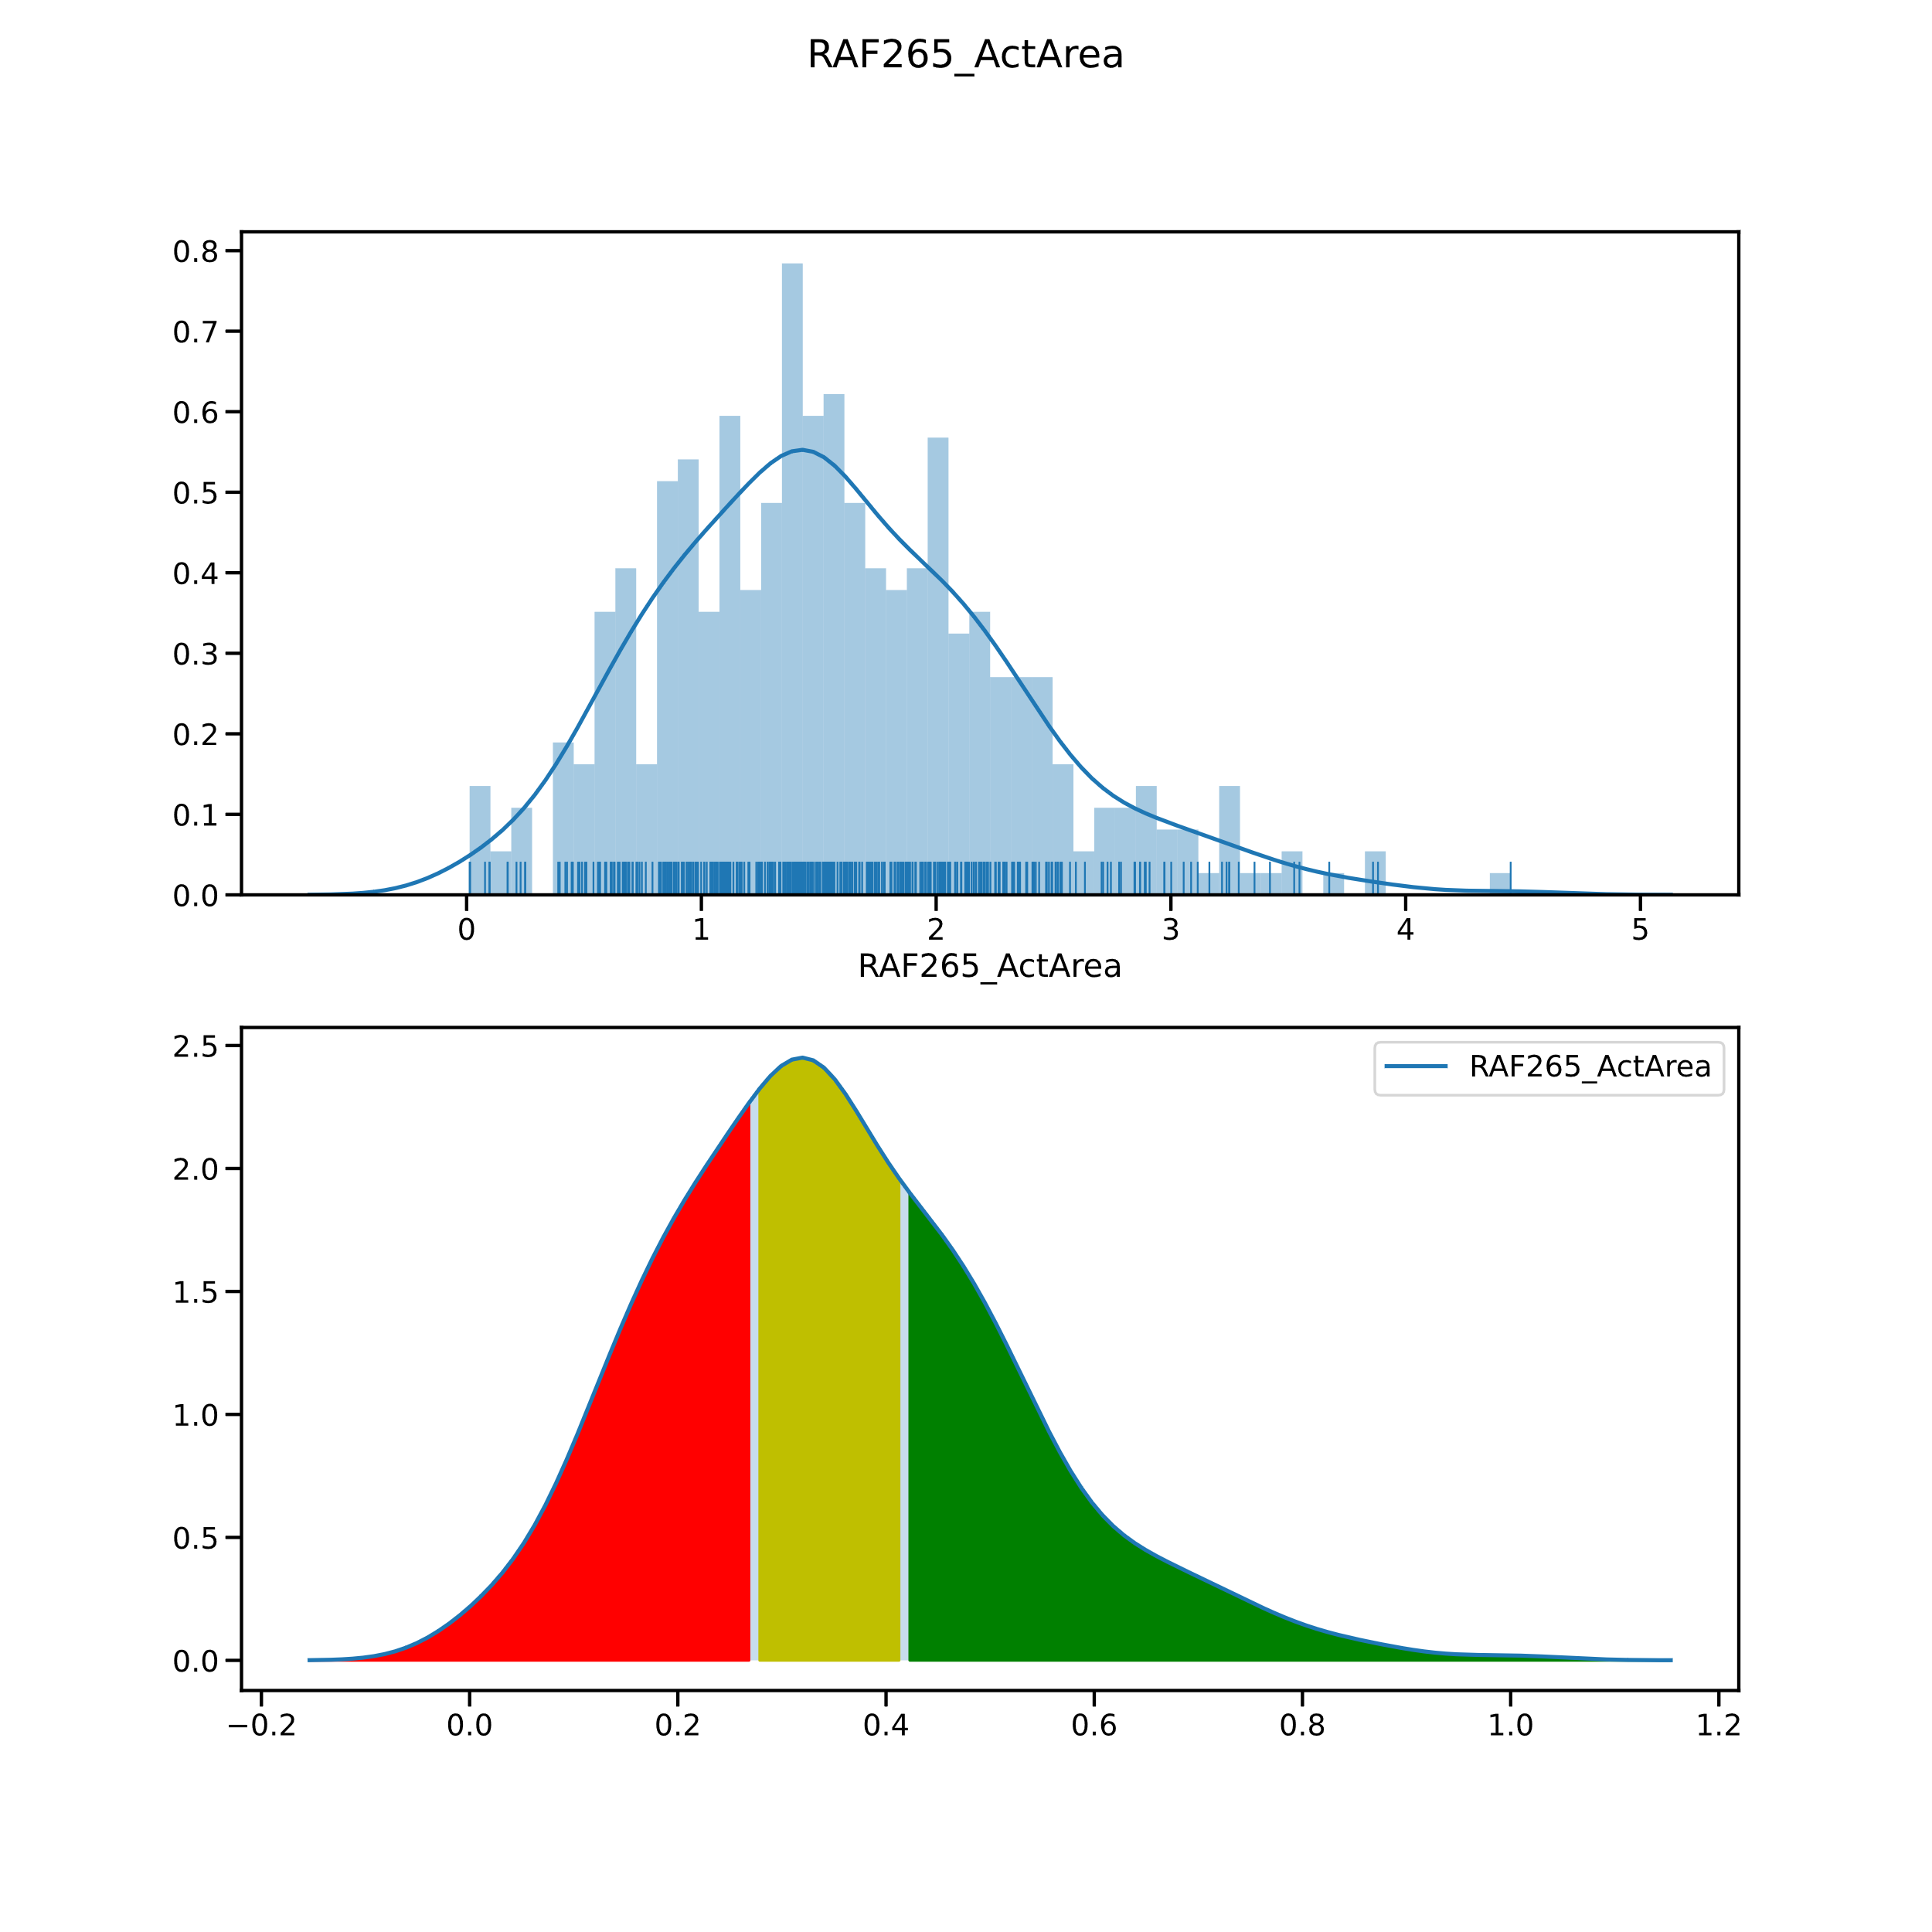

Slide 27
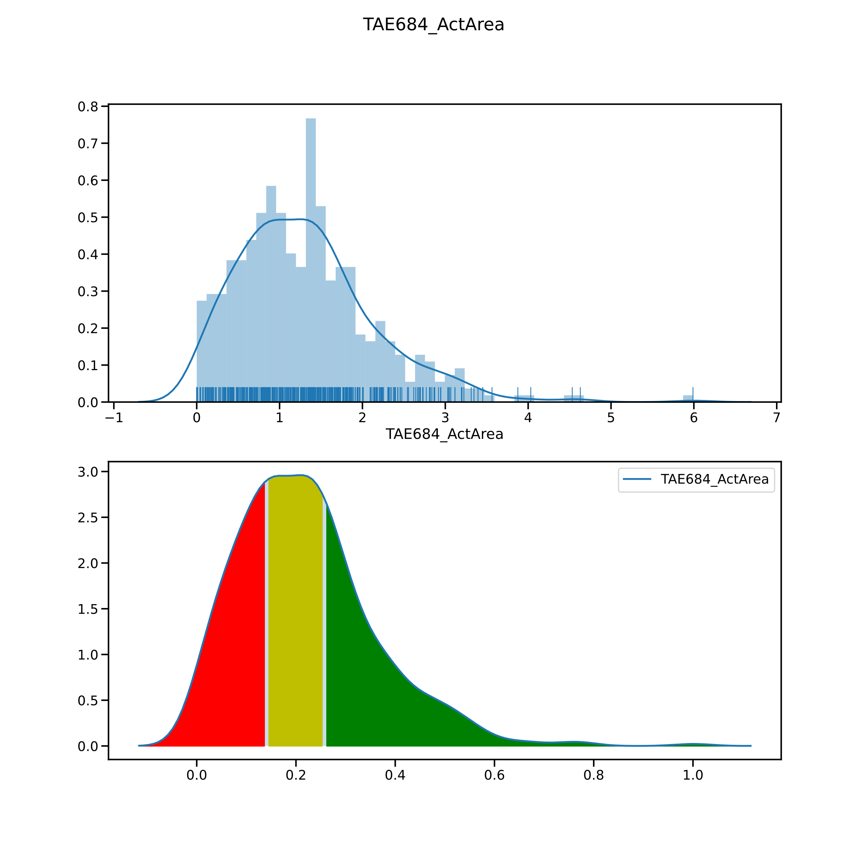

Slide 28
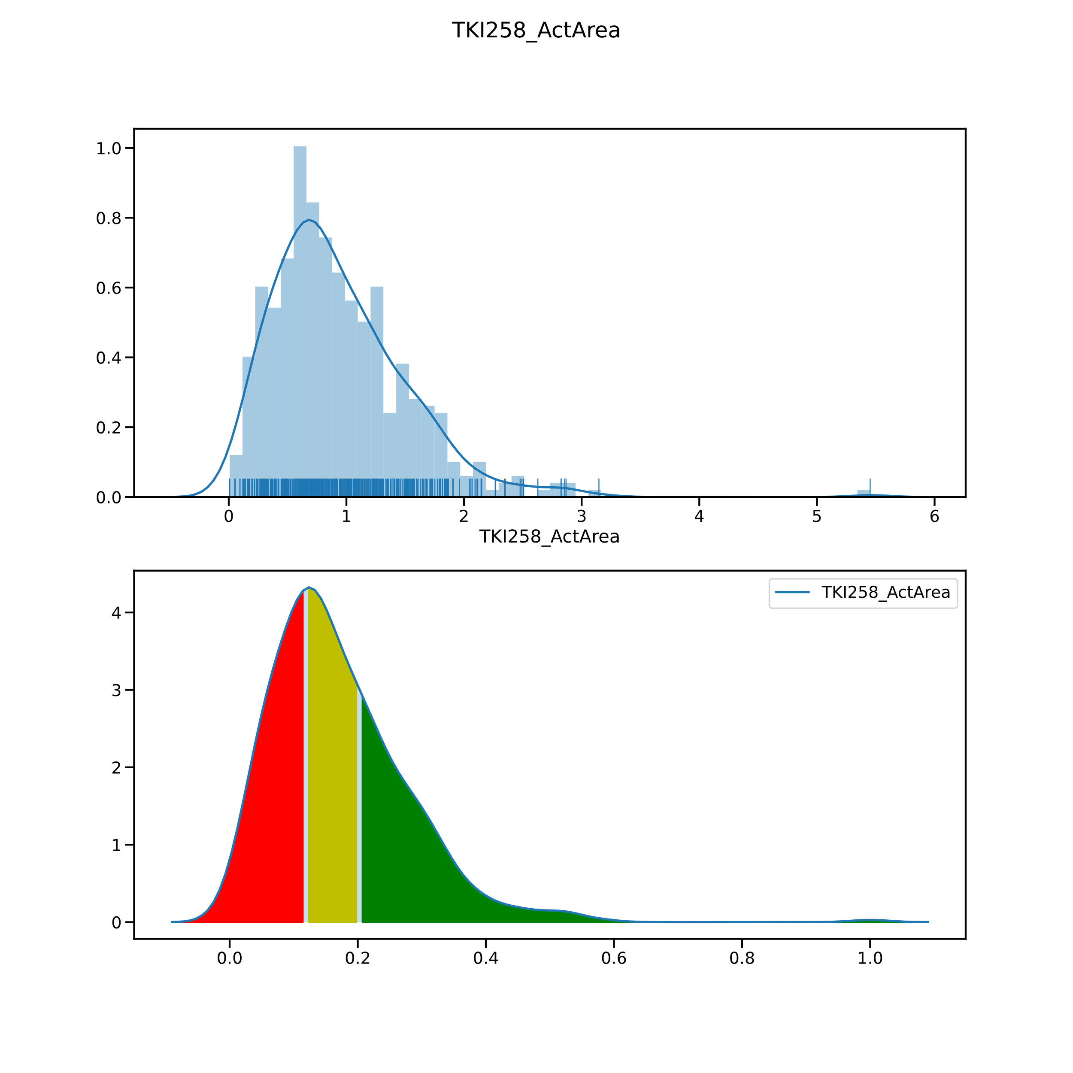

Slide 29
